Slide 1

sustainability plan
DRAFT
Presented by:
Cheryl Sears
Narine Madramootoo

Slide 2

CONTENTs
About the Plan
Define Sustainability
Regulatory Environment
Vision
Mission
Focus Areas
Questions and Comments

Slide 3
About the Plan
Framework for institutionalization
ARC Strategic Goal #4
  Vibrancy and Resiliency
    “The college promotes a culture of innovation, entrepreneurship, sustainability, and transparent communication. Proactive, effective, and efficient operational systems and governance and data-informed approaches to planning, decision-making, and resource allocation to provide a high level of service to our students, community, and to one another.”
Supports Los Rios Board Policy 8370 Waste Reduction and Recycling program Administration

Slide 4
About The Plan
Goal of Sustainability Improvement Plan Team
Assess Current State
Consider the Future
Make Recommendations
Foster Cultural
Shift

Slide 5
Defining sustainability
Resource Consumption
Present Needs
Future Generation
Environmental Consequences

Slide 6
Regulatory mandates
Global warming solutions Act of 2006
Reduction of GHGs
Senate Bill 375
Reduction of GHGs associated with urban sprawl
California Renewables Portfolio Standard (Senate Bill 1078)
Increase renewable energy procurement
AB 1826 Mandatory Organics Recycling
>4 cubic-yards of organic waste
HR 4184 Food Recovery Act
Aimed at reducing food waste and promoting food recovery

Slide 7
vision
Promotes environmental justice and recognizes sustainability efforts
Create a sustainable, equitable, and just future
Interconnectedness of systems
Support the global effort against climate change
Guiding principle for all work internal and external of the college

Slide 8
Mission
Foster a culture around sustainability
Raise awareness and engagement
Promote environmental and social justice
Improve quality of life
Present and Future generations

Slide 9
Focus areas
Leadership
Communication
Built Environment
Food
Academics
Transportation, Energy, and Climate
Landscape and Biotic Environment
Waste Management
Water

Slide 10

Leadership
Assessments
Isolated efforts
Lack of community involvement
Minimal overall impact
Recognition of sustainability efforts
Minimal coordination
Recommendations
Institutionalize a Sustainability Program
Office of Sustainability
Funding for Sustainability Activities
Lack of centralized leadership

Slide 11
Office of sustainability
OOS
Educate
Translate
Institutionalize
Amplify

Slide 12

Communication
Assessments
No official social media presence
Minimal active messaging around sustainability and climate change
Need more public outreach events
Recommendations
Develop a Public Relations strategy
Events and Outreach
Need to encourage active participation

Slide 13

Built environment
Assessments
Build and remodel to LEED design standards
Many old inefficient building on ARC campus
Recommendations
Evaluate and enhance sustainable practices in current and future built environment
GSA and LEED sustainable design criteria
Advocate for sustainable policies and practices
Operational and maintenance practices
Adopt USGBC LEED building design
Platinum
Gold
Silver at minimum

Slide 14
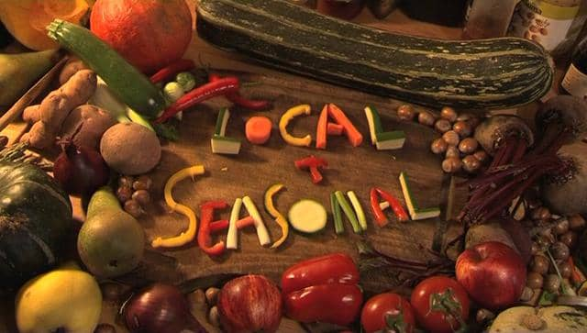
Food
Assessments
No requirement for biodegradable utensil
No requirement for vendors to align with ARC environmental goals
Need a student center food waste management program
Lack of emphasis on a sustainable food chain
Recommendations
Transition to environmentally friendly food service products and materials
Influence our community and foodservice vendors
Increase composting
Advocate for sustainable practices and food chain

Slide 15

academics
Assessments
Lack of sustainability infusion throughout the academic program
Recommendations
Infusion of sustainability through education
Training and internships
Hiring practices
Lack of emphasis on climate change throughout the curriculum
Need to implement a sustainability professional development program

Slide 16
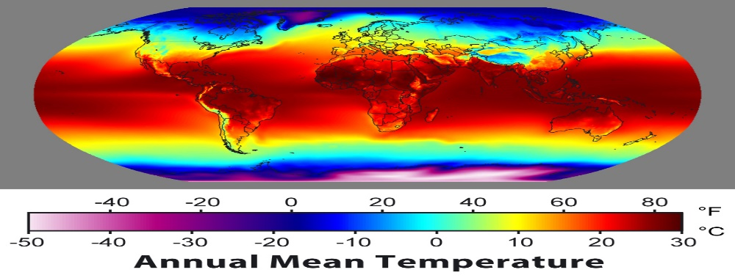
Transportation, Energy, and Climate
Assessments
Anthropogenic climate change
Need to reduce fossil fuel dependency
Embrace public transportation
Recommendations
Assess and enhance climate control practices
Support ARC community and the student population
Electrify campus fleet
Advocate for public transportation infrastructure
Improve campus infrastructure to meet current and future demands
Negative environmental impacts
Negative impacts on impacted communities
Need better energy controls

Slide 17
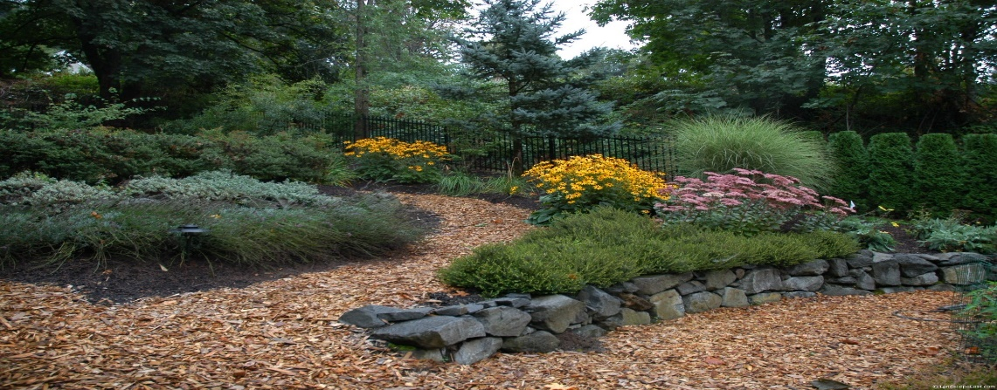
Landscape and biotic environment
Assessments
Tree Campus USA
Invasion of non-native species
Utilization of non-native species in design
Recommendations
Increase the use of native plants
Effective landscape management
Collaboration and restoration
Embrace sustainable landscaping

Slide 18
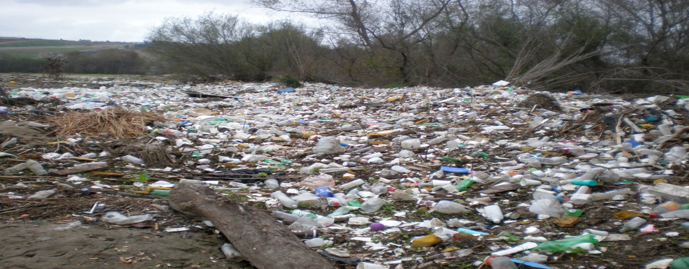
Waste management
Assessments
Commit to waste reduction and diversion
Increase recycling and composting
Improve segregation of waste streams
Recommendations
Continue efforts to reduce, recycle, and reuse
Build on our commitments
Create polices and collaborate with CCC system

Slide 19

water
Assessments
Valuable resource
Overstressed system
Plan to reduce consumption
Recommendations
Reduce potable water consumption
Modification of delivery systems
Increase access to clean water
Population growth = increase demand

Slide 20
How It Works?
OOS
Leadership
Communication
Built Environment
Food
Academics
Transportation, Energy, Climate
Landscape and Biotic Environment
Waste Management
Water
Notes:
The OOS will serve as the central hub to coordinate activities around the campus. OOS will take the leadership roll and be a driver for sustainability.

Slide 21
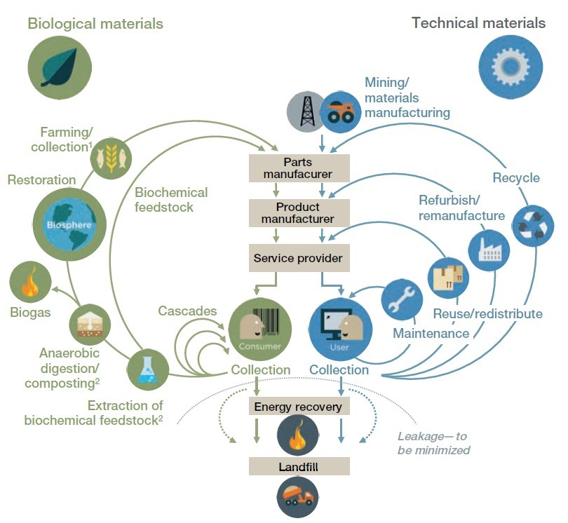
Closing thoughts
Plan should be viewed holistically
Climate change will impact every aspect of our life
As an institution of learning:
  We must educate
  Reshape our culture and lead by example
  Support our students and community
  Join the global effort
  A beacon of sustainability
2/3 (66%) of extracted resources are wasted
Adopting a circular economy will reduce waste
Courtesy of: world economic forum.org (http://www3.weforum.org/docs/WEF_ENV_TowardsCircularEconomy_Report_2014.pdf)

Slide 22

Questions and Comments

