Slide 1
American River College
Emergency Operations Plan (EOP) Update
February 25, 2020 Operations Council Meeting
Consultant: Brenna Howell, Howell Consulting, Inc.

Slide 2
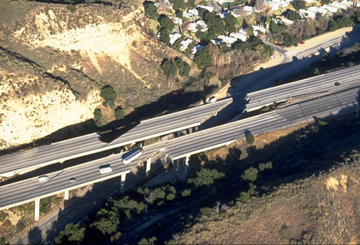
Table of Contents
What is an Emergency Operations Plan (EOP)?
Why is it Required and by Who?
EOP Project Overview
EOP Update Process
What’s In the Plan
Next Steps

Slide 3
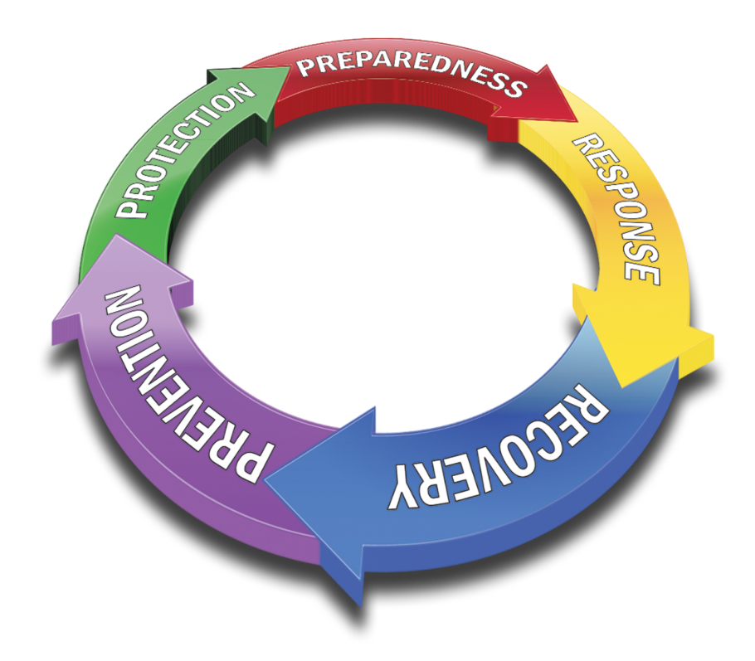
What is an Emergency Operations Plan (EOP)?
A document that defines the scope of preparedness and emergency management activities necessary for an agency or organization
Assigns responsibilities
Sets authorities
Establishes the EMO
Defines the overall coordination

Slide 4


Who Mandates this Plan and Why?
An EOP is mandated by:
Federal Emergency Management Agency (FEMA)
National Response Framework (requires a detailed EOP addressing various hazards)
Standardized Emergency Management System (SEMS)
Federal and State Preparedness Funding requires the development of EOP

Slide 5


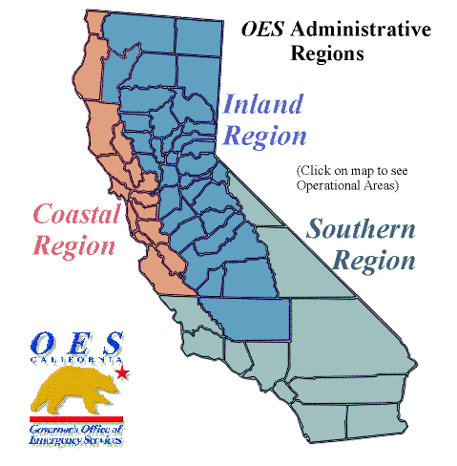

ARC is Part of a Larger System
Federal Government
State
OES Region
Operational Area
Local Government
Notes:
SEMS was adopted in Senate Bill 1841 Government Code 8607.
SEMS regulations are described in California Code of Regulations, Title 19, Division 2, Chapter 1.
Local governments must use SEMS to be eligible for funding of their response-related personnel costs under state disaster assistance programs.

Slide 6
EOP Update Project Overview
Retained Howell Consulting, Inc. to assist the District with the following:
2019 EOP Update – Phase 1
Emergency Operations Center (EOC) Annex and support documents – Phase 2
Staff Training and exercises – Phase 3

Slide 7
EOP Update Process
1. Update District & College EOPs
2. Kick-off and Planning Meetings w/each of the 4 College main campus locations
3. Draft Plan completed, review time and presentations to Operations Council
FINAL BASIC PLANS COMPLETED!

Slide 8
What’s in the Basic EOP?
Promulgation
Approval and Implementation
Purpose, Scope, Situation and Assumptions
Concept of Operations
Direction, Control, Coordination
Information Collection, Dissemination, Analysis

Slide 9
What’s in the Basic EOP? Cont’d
Communications
Administration, Finance, Logistics
Preparedness, Training and Exercises, After Action Reporting
Authorities and References
Acronyms

Slide 10
Next Steps
Review Draft Document
Provide Feedback to Point of Contact
Incorporate comments
Finalize Document
Start Phase 2 work (March 2020)
Let our advance worrying become advanced thinking and planning.”
-Winston Churchill

Slide 11

Questions ???

