Slide 1

Homebase Pathway Communities
The next phase of our STUDENTS FIRST redesign

Slide 2
What Our Students Say
Maybe first semester classes could already be planned out before you get here
I wish there was easier access to career information to see the differences in yearly salary
It would be great if we could see things that universities provide sooner
I’m trying to think of how you can get someone to explore all of these things and not be intimidated
Based on October 2017 Focus Group

Slide 3
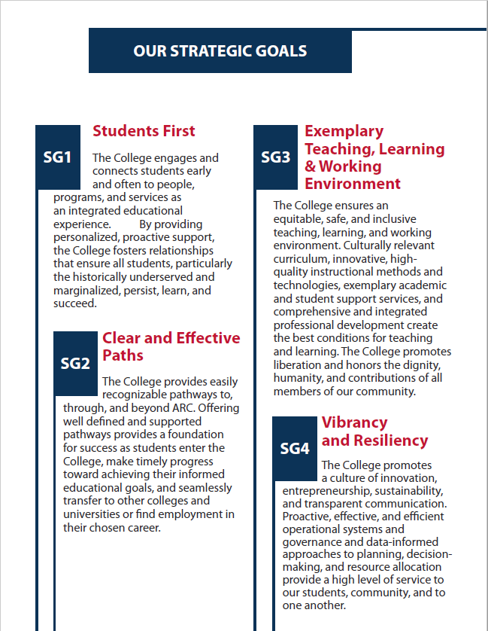
ARC Strategic Plan
All students will be part of a “Pathway Community” that connects them to their academic and career interest areas.
-- 2018 IPaSS Report, p. 5

Slide 4
Students First … By Design
The College engages and connects STUDENTS early (ACHIEVE) and often (HOMEBASE PATHWAY COMMUNITIES) to people, programs, and services as an integrated educational experience.
By providing personalized, proactive support, the College fosters relationships that ensure all students, particularly the historically underserved and marginalized, persist, learn, and succeed.
Strategic Goal 1

Slide 5
Focusing Related Efforts
2019-2020
2020-2021
Academic Support
Aligned to Areas of Interest
Achieve@ARC Scaled
(n=5,000+)
Success Team Case Management
Aligned to Areas of Interest
Career and/or Major Exploration
HomeBase Pathway Communities
Newly Entering Students
All Students
GUIDED PATHWAYS FRAMEWORK
Clarify the Path
Enter the Path
Ensure Learning
Stay on the Path
Pillar 1 Pillar 2 Pillar 3 Pillar 4

Slide 6
ARC’s Dual Strategies
ACHIEVE
HOMEBASE PATHWAY COMMUNITIES
Proactive Outreach and Engagement
  Onboarding and case management for newly entering students
  Enables successful transition to college
  Sustained for the first year with a smooth handoff to a HomeBase in second semester
  Centrally managed from the Welcome and Support Center
Receptive and Convenient (draw students in)
  Named “HomeBase” by students in Fall 2019
  Enables successful pathway navigation, career preparation, and/or transfer
  Ongoing for duration of a student’s time at ARC through goal completion
  Located in a student’s path – near where they take pathway classes

Slide 7
Student Flow
First-time Students
ACHIEVE
2nd Semester
HomeBase
Pathway Communities
Transfer Students
Re-entry Students
Continuing Students
Others who have prior college experience

Slide 8
What is a HomeBase Pathway Community?
Collaborative effort to provide integrated support (Instruction and Student Services)
  Personalized major, career, and transfer assistance
  Organized by area(s) of interest/programs of study
  Depth of discipline-specific expertise
  Physical and virtual presence
All students will be part of a “Pathway Community” that connects them to their academic and career interest areas.
-- 2018 IPaSS Report, p. 5

Slide 9
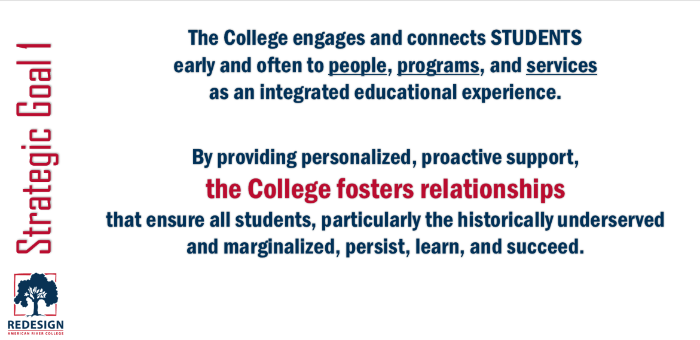
Key Components
Dedicated space to build relationships and develop a sense of community
Frequent opportunities to engage with students in a meaningful way

Slide 10

Finding a HomeBase
Distributed across campus in six locations
Close in proximity to faculty and program expertise
Accessible prior to the Fall 2020 semester

Slide 11




Proposed Locations
Diane Bryant STEM Innovation Ctr.
2nd Floor
Davies Hall
(combined HomeBase)
Arts & Science Building
Area of Interest:
BUSINESS
Areas of Interest:
LANGUAGE & COMMUNICATION
PEOPLE, CULTURE & SOCIETY
Area of Interest:
ARTS

Slide 12




Proposed Locations
Computer Math Complex (CMC)
Health & Education Area
(combined HomeBase)
Diane Bryant STEM Innovation Ctr.
First Floor (STEM Success Center)
Area of Interest:
MANUFACTURING, CONSTRUCTION & TRANSPORTATION
Areas of Interest:
HEALTH, HUMAN SERVICES & WELL BEING
PUBLIC SERVICE
Area of Interest:
SCIENCE, TECHNOLOGY, ENGINEERING & MATH (STEM)

Slide 13
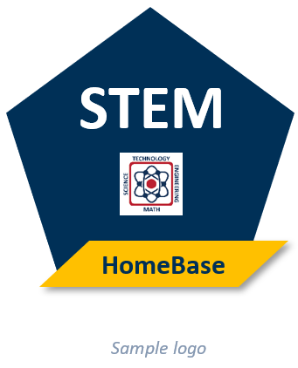
Team-based Approach
Each HomeBase will be supported by the expertise of:
  Classified Staff
  Counselors
  Instructional Faculty
  Peer Mentors

Slide 14
HomeBase Features
Service counter (e.g., quick questions, forms)
Pathway-specific counseling, advising, and educational planning
Program maps and career resources
Thematically-designed workshops
Major exploration
Self-service kiosk (e.g., registration and payment of fees)
Enhanced referrals (connecting to the next service or expert)

Slide 15
HomeBase Connections
Some Possibilities:
Access to instructional faculty for mentoring, office hours, career guidance, and pathway-related activities
Interaction with peer mentors and other pathway students
Non-ARC pathway expertise (e.g., industry experts or CSU/UC faculty)
Well-coordinated pathway communication
Let’s design together … what are your thoughts and ideas?

Slide 16
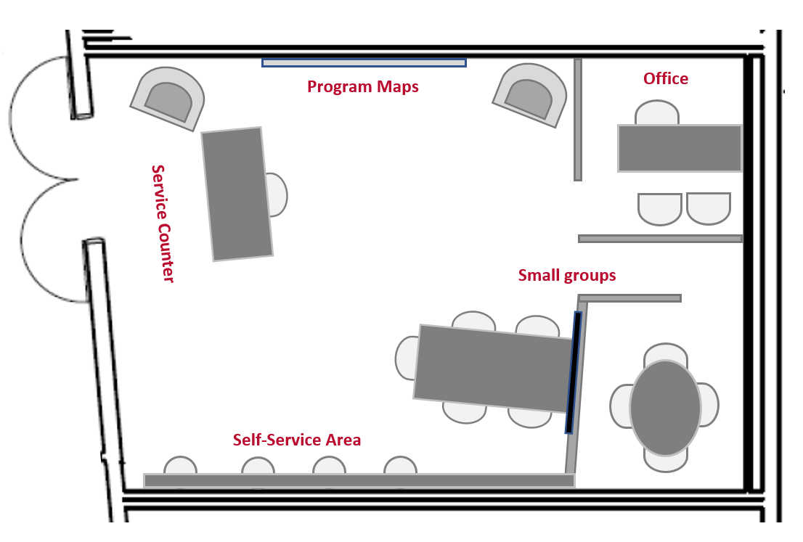
Conceptual HomeBase Design
(actual configuration varies)

Slide 17
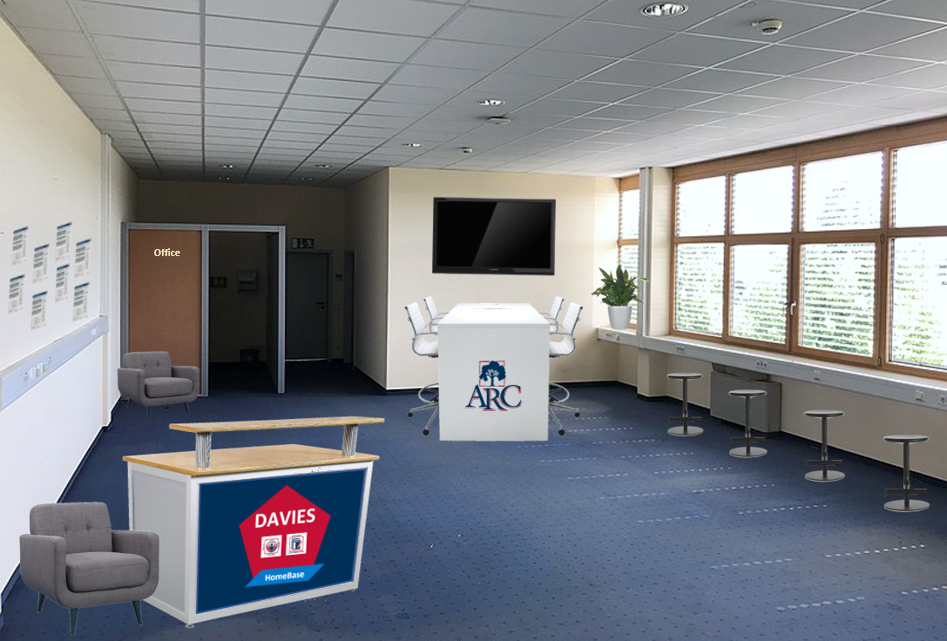
Glimpse of a HomeBase
Conceptual Design
(actual configuration varies)

Slide 18
Next Steps
Spring 2020
  Facility planning
  Staffing
  Development of services and processes
  Facility remodeling begins (sequenced to minimize impact)

Slide 19
Next Steps
Summer 2020
  Marketing: awareness campaign
  Facility remodeling completed
  Moving and settling in (late July/August)
  HomeBase locations open to serve students preparing for fall

Slide 20
Next Steps
Fall 2020 and Beyond
  Build out and deploy additional services
  Assess effectiveness and refine services
  Collaborate and iterate

Slide 21
Thoughts and Questions?

