Slide 1
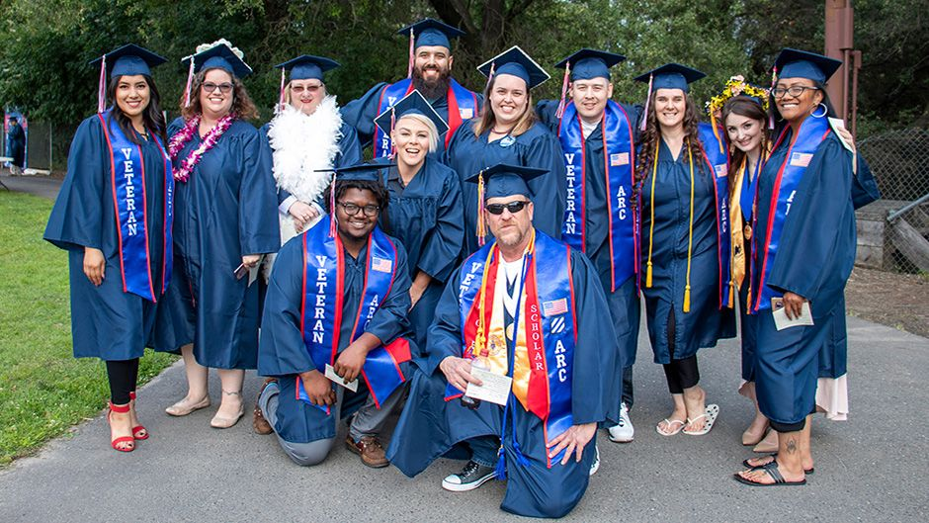
Equitable Outcomes Assessment Key Findings
American River College | Fall 2025 - Spring 2026
Lauren Ford, Ed.D.
Lasana O. Hotep
Katrina Pantig Naval

Slide 2




The Team
Lasana O. Hotep
Founder & Lead Consultant
Director, Staff Engagement and Belonging
UC Berkeley
Lauren Ford, Ed.D. Strategic Consultant
Interim Vice President of Student Services
Dean of Career and Workforce Development
Skyline College
Katrina Pantig Naval
Strategic Consultant
L&D Strategist, Staff Engagement and Belonging
UC Berkeley

Slide 3

Today’s Agenda
Intro
Background
Key Findings
A Way Forward
Next Steps/Discussion
Notes:
Agenda
Intro - 5 min
Background - 10 - 12 min
Key Findings - 20 min
A Way Forward - 10-12 min
Next Steps/Discussion - 10 min

Slide 4
Background
Context
American River College invited Hotep Consultants to facilitate an Equitable Outcomes Assessment of practices, policies and assessments to uncover potential barriers to student success -- specifically as it relates to the impact on historically minoritized students.
Assess current practices at ARC- including existing equity-centered work
Provide recommendations for continued improvements
Ensure equity is embedded in all areas of college: policy, practice, and praxis
Timeline
April-May
Collection of key institutional documents
Conducted virtual stakeholder focus group discussions
Collected responses from an employee survey and a student survey
July-September
Analyze all three sets of data: documents, focus groups, and surveys
Oct-Dec Present findings to key constituent groups
Notes:
To refresh us on the context for this project, in alignment with the District Board Goal 2 of conducting an Equity Assessment Project, Hotep Consultants was invited by the District Office and ARC to facilitate an Equitable Outcomes Assessment to examine practices, policies, and assessments at the college to identify any potential barriers to student success with special attention to how those barriers impact disproportionately impacted students. To goal of this process was to assess current practices including existing equity centered efforts, provide recommendations, and help ensure that equity is embedded in all areas of the college.
In the spring we collected three sets of data from a document analysis, a student survey, employee survey and focus group discussions.
During the summer we analyzed the data and this semester we’re presenting findings with the goal of providing the college with a final report at the end of the semester.

Slide 5
Key Definition: Equity
Hotep Consultants
Equity is developing policies, practices, and assessments within an organization that take into consideration the unique challenges and barriers faced by disproportionately impacted groups. This requires reallocating fiscal and human resources to address areas with the greatest needs in order to close opportunity gaps.
American River College
Equity defined as providing educational opportunities and support that meet the needs of the community, especially those who are historically underserved, marginalized, or disproportionately impacted. The ARC equity statement affirms that the college is committed to equity and social justice through equity-minded education, transformative leadership, and community engagement. (ARC Institutional Equity Plan)
Notes:
To help ground us in this presentation, on the screen we’ve shared our organizations definition of equity which was read during the focus group discussions.
At Hotep Consultants, we believe that equity is……
According to ARC’s institutional plan, equity is…

Slide 6

Key Definition: Anti-Racism
Intentionally focusing on policies and practices that produce or sustain racial equity between racial groups
Requires constant assessment and reflection
Is less about the creator – is solely about the outcome
Notes:
Ijeoma Oluo, author and scholar, shares, “The beauty of anti-racism is that you don’t have to pretend to be free of racism to be an anti-racist. Anti-racism is the commitment to fight racism wherever you find it, including in yourself. And it’s the only way forward.”
In addressing Racism and “Anti-Racism” , our intentional focus on policies and practices that produce or sustain racial equity and between racial groups, requires constant assessment and reflection, and is not about the creator or individual and is about the outcome.

Slide 7
Guiding Research Questions
To what extent is the environment at ARC diverse and inclusive?
To what extent do ARC’s administrative policies and practices encourage a systemic and collaborative approach to diversity, equity and inclusion?
To what extent do ARC’s instructional policies and practices help cultivate a learning experience that is engaging and empowering for historically minoritized students?
In what ways can ARC support changes to current policies, practices, and procedures in order to improve the quality of instruction and services for students?
To what extent are ARC’s budget and resource practices informed by a student-ready and equity minded lens?
Notes:
Here are the guiding research questions for the overall assessment, adapted from an Equity Audit brief written by Hanover Research. We wanted to learn about five key areas so we’re interested in learning the extent to which…
The environment is diverse and inclusive
The nature of collaboration
Instructional policies and practices
Opportunities that exist to improving the quality of instruction and services
What budget and resource practices look like

Slide 8
Key Competencies
Critical Reflection
The practice of assessing an organization’s culture, policies, and practices and identifying ways to change, adapt, and grow to improve outcomes for students.
Demonstrating Belief in Students
This is the authentic and unwavering belief that students (in particular, students of color, first generation, and/or low income) have the capacity to learn and be successful.
Racial Literacy
Understanding what race is, its relationship to inequity, and how to respond to racial tension, discrimination, and inequitable outcomes with an anti-racist lens.
Action Oriented
Being action-oriented requires intentional steps and efforts towards dismantling inequitable practices and policies within the institution.
Sense of Welcome & Belonging
Students feel welcomed and a sense of belonging when an institution values students’ cultural/racial differences, connects them to opportunities and resources, and creates community for students.
Utilizing a Campus Equity Ecosystem
Creating change requires the organization function as an equity-minded community meaning that all individuals, constituent groups, departments, and services understand what their role is in student success and leverage resources to advance equity and student success in alignment with student equity and achievement plan and strategic plan
Notes:
On the screen are a list of six competencies that we feel are critical for employees to develop in order to advance equity at the institution. Each section in the survey corresponds with these competences with the exception of the final section, which was the same questions for all employees that focused on campus climate. So when thinking about these competencies, we’re interested in learning the extent to which employees
Practice critical self reflection which includes an awareness of their identity and focusing on continuous improvement of the college in order to improve outcomes for students
Believe in students ability to succeed despite that our outcomes show, which is the opposite of a “deficit minded orientation” of students where we blame them for their shortcomings or perceived flaws that prevent them from being successful
Racial literacy, similar to race consciousness, meaning understanding how racial disparities are connected to a system of inequity. Because we understand that, we can engage in anti-racist actions when there is overt and subtle racial tension and discrimination.
Being action oriented meaning employees recognize their agency which makes a difference in students lives and the willingness to take intentional actions to dismantle inequitable practices and policies.
How a Sense of Welcome and Belonging is fostered in the design, communication, and relationships with students.
And then finally, utilizing a campus equity ecosystem meaning that employees understanding how the institution, holistically and intentionally has been redesigned and positioned to close equity equips from looking at the roles of various individuals, departments, how resources are allocated and how the culture and climate encourage community oriented efforts to address the needs of students.

Slide 9
EOA Approach: Data Reviewed
Institutional Survey - 281 employee responses, 609 student responses
  Participation encouraged campus-wide and with key leadership groups. Automated reminders were sent to employees and students throughout the process.
Focus Group Discussions - 16 hours, 63 participants engaged in 13 sessions
  Participants represent the following stakeholder groups: students, student services & support professionals, instructional faculty, and management.
  Students: 1, Faculty: 1, Classified Professionals: 28, Administrators: 33
Document Analysis - 90 documents reflecting policies, practices and assessments
  District hiring policies, district performance review documents, job bulletins institutional goals, institutional planning, resource allocation processes, student program advertisements, survey results etc.
Notes:
With the help of this core team, we were able to collect three sets of data to help answer the guiding research questions we presented.
For the institutional survey
We received 281 employee responses (22% response rate, out of 1,234 employees) and 609 student responses (2% response rate out of 30,377)
Participants received automated reminders from surveymonkey through out the three week period the survey was open. This team was also asked to encourage participation from colleagues and students.
From this data, we gained insight into ARC’s culture and climate including the extent to which employees feel supported and valued by the institution, the practices they engage in to support students, some of the issues and challenges with shifting to a student-focused and student-ready approach, and insights to the student broad experience. The student survey provided insights as to the student experience with employees, peers, and institutional processes.
For focus group discussions
We conducted about 16 hours worth of focus group discussions and engaged 63 participations in 13 different sessions.
Management and Classified professional staff were a majority of participants.
From this data we gained insight around employees’ level of understanding, engagement, and feedback around equity, diversity, and inclusion efforts at ARC.
For the document analysis
We reviewed 90 documents. Each document reflected a policy, practice or assessment and was either employee facing, student facing or operational.
This data gave us insight into structures, messages and practices that support or create barriers to equity and anti-racist efforts

Slide 10



S.E.T. Framework
Student Ready Institutional | Equity Minded Individual | Transformative Service
Policy The record of what we say we do | Practices Doing what we said we would do | Assessment The result of doing what we said we would do
Notes:
Kat
This graphic represents the SET framework, the philosophical foundation that informs our guiding questions, our approach to the audit, and the way we show up/facilitate the experience for the college. There are six key components of the framework (read each component) and we assess the intersections of each area.
Student Ready
Equity Minded
Transformative

Slide 11
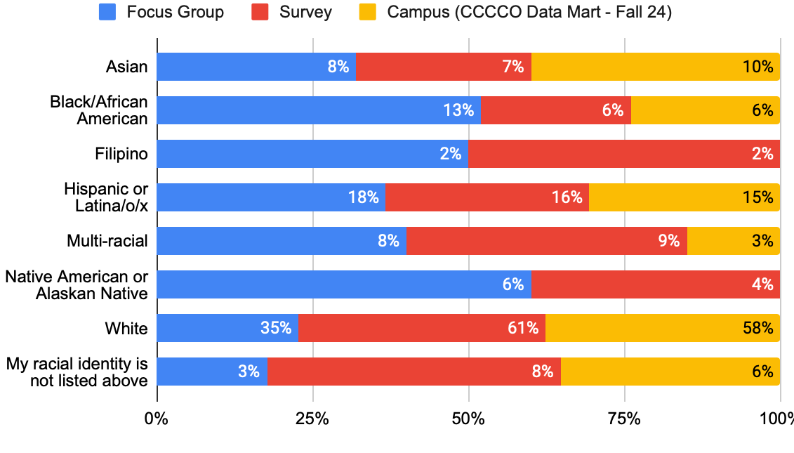
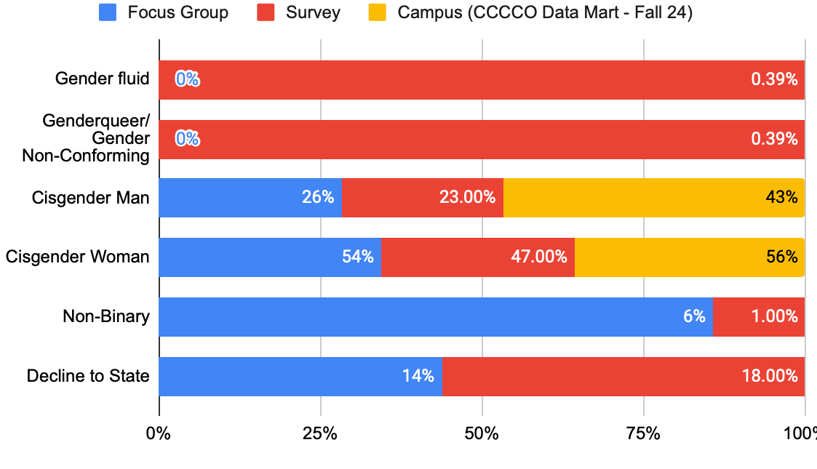
Participant Demographics - Employees
Race/Ethnicity
Gender
Notes:
For employee demographics, we had a representative sample based on racial identity and gender identity

Slide 12
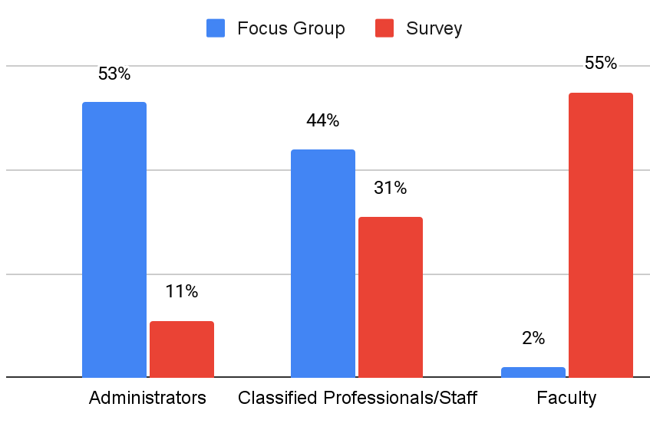
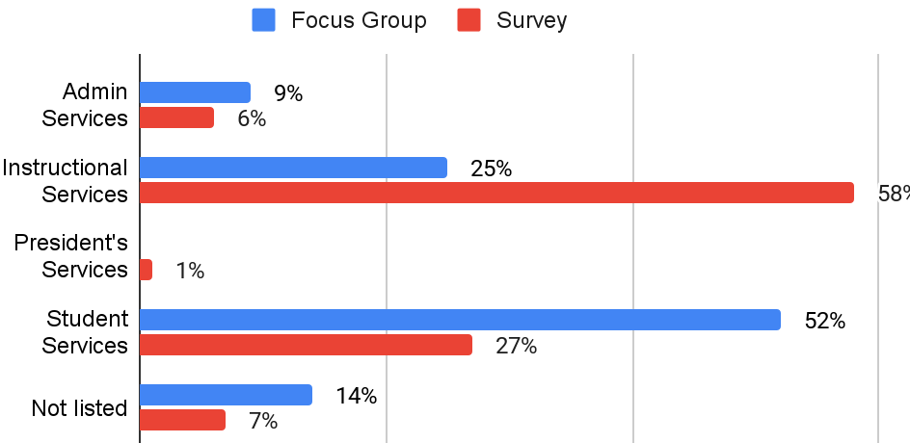
Participant Demographics - Employees
Constituency Groups
Service Areas
Notes:
We were glad to have heard from all employee constituency groups and to get representation from Instructional, Administrative and Student Services with the highest level of engagement being from instruction in the surveys.

Slide 13
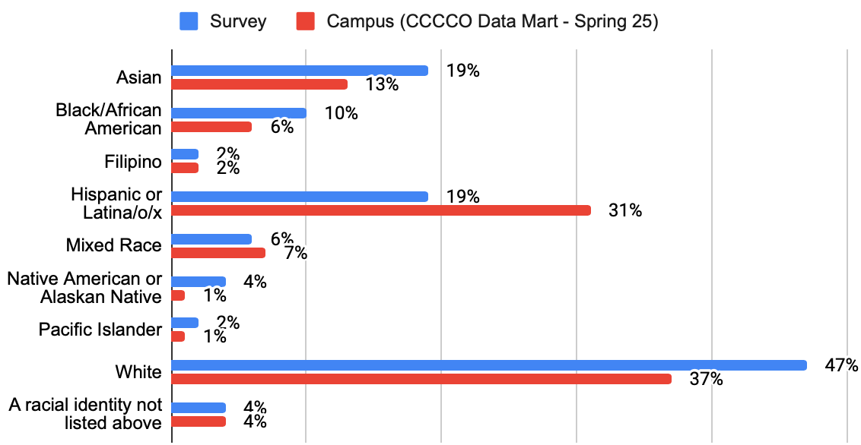
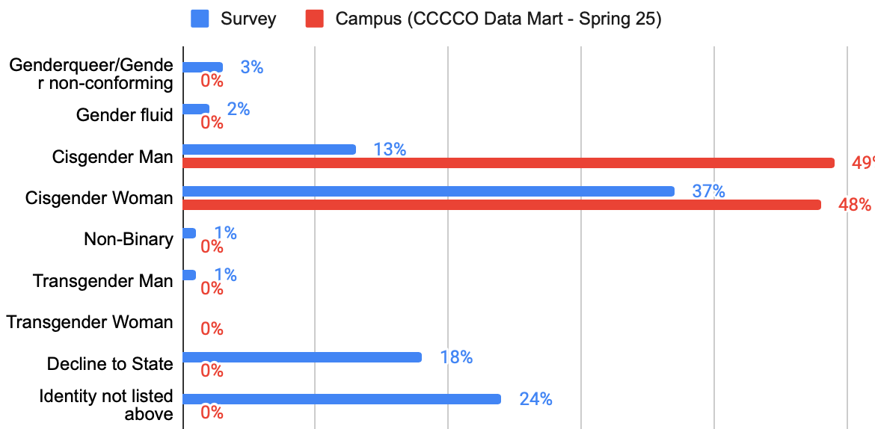
Participant Demographics - Students
Race/Ethnicity
Gender
Notes:
For students, we also had a representative sample based on racial identity and gender identity
Racial Identity
High engagement from white, asian, black and native students
Hoped from more representation from latinx students

Slide 14
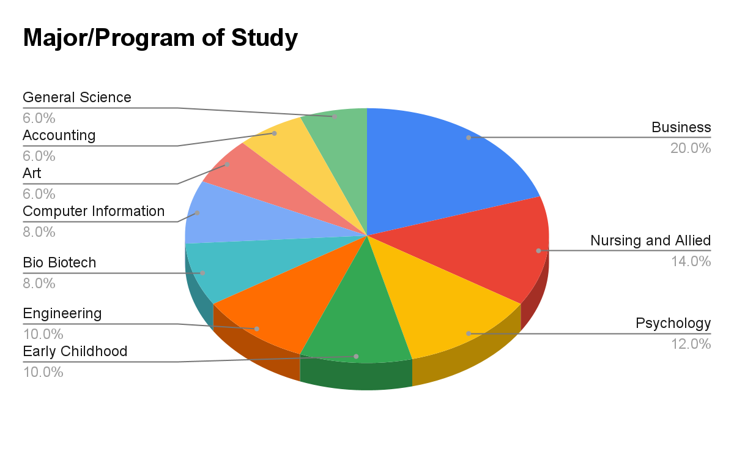
Participant Demographics - Students
Student Educaional Goals | n | %
Earn an AA | 157 | 26%
Earn an AS | 121 | 20%
Earn an ADT | 129 | 21%
Earn a Certificate | 104 | 17%
Transfer to a 4-yr university | 247 | 41%
Earn Technical Skills for workforce | 58 | 10%
Explore and learn for personal enrichment | 79 | 13%
To take classes for my 4 yr degree | 35 | 6%
Notes:
Total of 593 students responses, majority stated an educational goal of transferring to a 4-year or earning some form of 2 year degree;
Looking at our student demographics, we adequate representation from all homebases. We recognize that we received responses in the ‘non listed’ section because students may not identify with the homebase or didn’t notice where their specific major was listed for the response categories.

Slide 15
Limitations
Gaps in information / limited access and engagement
  We appreciate the perspectives represented and recognize that receiving more employee survey responses, documents, and student participation in focus groups would have provided fuller picture of what it’s like at ARC. We can only review the information we have access to – whether information shared directly from ARC or information we found on our own. There may be gaps in our understanding of current processes or policies.
  If you notice that our interpretation of the information we have is a bit off, dated, or missing, please let us know and feel free to share any updated information with us so that we can reassess.
Surveys can only tell so much
  The insights shared were helpful to get a sense of the experiences of employees and students on campus. Surveys can sometimes tell us “what” but they might not always be able to explain the “why” or “how”.
Timing
  Some employees and students may not have yet had enough familiarity with the institution to answer the questions more broadly. The spring semester is also a very busy time and so we recognize the students and employees were having to navigate competing priorities and responsibilities.
Notes:
Now we’ll review the limitations of the study that were out of our control
Gaps in Information / limited access and engagement
We are thankful for the perspectives represented in the research and support we received to access information. And we recognize that having more documents, employee survey responses, and student participation in focus groups would have provided a fuller picture of what it’s like at ARC.
Of course we can only review what we have access to whether it shared directly from the college or information we found on our own.
Because of that, there may be gaps in our understanding of current processes or policies so throughout the presentation, if you notice that our interpretation of the data is off, dates or missing, let us know and share that info fo we can reassess.
Surveys can only tell so much
The insights were helped to get a sense of employees and students experiences.
Having said that, surveys often tell us the what but they don’t always explain the why or how.
Timing
Timing also matters because some employees and students may not have yet had enough familiarity with the institution to answer the questions more broadly. The spring semester is also a very busy time and so we recognize the students and employees were having to navigate competing priorities and responsibilities.

Slide 16
Preview of
Key Findings
Notes:
5:50 p.m.
In the format of the key findings section, we’ll first go over the overarching themes.
Next we’ll share some highlights and opportunities for growth organized by our SET framework we reviewed

Slide 17
Overarching Themes
Equity is a core value college-wide but inconsistent in practice
Equity was widely recognized as a core institutional value, yet its meaning and application varied significantly across employee groups.
Institutional bureaucracy as a barrier limiting equity implementation
Employees consistently identified institutional bureaucracy (e.g. procurement processes, outdated forms, and unclear communication) as a barrier to equity. Administrative systems, designed for compliance rather than flexibility, were perceived as incompatible with student-centered, equity-minded work.
Strengths in student support, gaps in connection
Students view ARC as diverse, academically supportive, and largely welcoming (e.g. faculty care and relationships with instructors, peer connection and student support programs supported students’ sense of belonging). However, improvements can be made with institutional communication, service consistency, and cultivating social connection for students.
Notes:
Equity is a core value college-wide but inconsistent in practice
Equity was widely recognized as a core institutional value, yet its meaning and application varied significantly across employee groups. Participants described strong leadership commitment—particularly from the president and vice presidents—but inconsistent definitions and uneven operationalization at the department and program levels.
Institutional bureaucracy as a barrier limiting equity implementation
Employees consistently identified institutional bureaucracy—slow hiring, rigid procurement, outdated forms, and unclear communication—as barriers that dilute or delay equity-focused innovation. Administrative systems, designed for compliance rather than flexibility, were perceived as incompatible with student-centered, equity-minded work.
Implication:
Strengths in student support, gaps in connection
Students view ARC as diverse, academically supportive, and largely welcoming (Faculty care and relationships with instructors, peer connection and student support programs supported students’ sense of belonging). However, improvements can be made with institutional communication, service consistency, and cultivating social connection for students. Inconsistent communication, limited outreach, and uneven inclusion create barriers to trust and engagement.

Slide 18
Key Findings - Student Ready (Institutional)
Highlights
Institutional plans strongly reflect equity-mindedness, racial equity, and opportunities to improve outcomes for DI groups. ARC’s Equity Framework looking at the interconnectedness of personal, professional and institutional equity. 22-25 Student Equity and Achievement Plan, Institutional Equity Plan, and Integrated Planning Guide Leadership, culture and trust building show signs of progress. Example: Addressing Davies Hall incident “Our admin has been reaching out. They’ve been creating some opportunities to interact with departments and individuals and I think that’s been critical.” (Employee quote, focus group)
Areas of Growth/Opportunity
38% of employee respondents (n=70) disagreed with the statement, “There is a culture of collaboration between instructional services, student services, and administrative services at ARC.” “As a whole, I believe there is a general culture of collaboration between instructional, student services and administration -- BUT time and time again there has been reluctance from some instructional faculty to work collaboratively with DSPS with a thought process that we are giving students an unfair advantage over their non- disabled peers.” (Employee Quote, Survey) Rigid business and administrative processes limit the institution’s ability to apply an intentional equity focus. Examples: Event planning, dependence on one-time grant funds, hiring and district office decisions. “For us a lot of things are planned last minute because of all the different policies and procedures we have to follow.” (Employee quote, focus group)
Notes:
Highlights
Institutional plans strongly reflect equity-mindedness, racial equity, and opportunities to improve outcomes for DI groups.
Evidenced in: 22-25 Student Equity and Achievement Plan, Institutional Equity Plan, and Integrated Planning Guide
Leadership, culture and trust building show signs of progress.
Classified staff and managers described the college as “more human-centered” and “less hierarchical” than before.
Administrators emphasized rebuilding trust through active listening and open communication.
Examples) data dialogues, divisional retreats, and open Q&A sessions—as signs of a cultural shift toward participatory decision-making.
“Our admin has been reaching out. They’ve been creating some opportunities to interact with departments and individuals and I think that’s been critical.” (Employee quote, focus group)
Areas of Growth/Opportunity
Developing a culture of collaboration across the college is critical for systemic impact.
38% of employee respondents (n=70) disagreed with the statement, “There is a culture of collaboration between instructional services, student services, and administrative services at ARC.”
“While many individuals make an effort to collaborate, the very fact that many of our areas and departments are perpetually short- staffed makes it difficult if not impossible for any but the most determined to make that collaboration pay off.” (Employee Quote, Survey)
Challenges with adapting business and administrative processes to have an intentional focus on equity.
Event planning: Creating a barrier of requiring insurance for vendors who are often ARC alumni with small businesses,
“For us a lot of things are planned last minute because of all the different policies and procedures we have to follow.” (Employee quote, focus group)
Within some of the job descriptions we accessed, there was no intentional messaging of the college’s priorities in terms of equity and student success.

Slide 19
Key Findings - Equity Minded (Individual)
Highlights
Employees demonstrated equity competencies: belief in students, creating a sense of welcome and belonging, and being action oriented. 85% (n=91) of faculty respondents agreed with the statement, “My course materials contain representations and stories of diverse individuals and communities.” 98% (n=64) of Student Services and Support Professionals agreed with the statement, “If I am not equipped to provide assistance to students, I locate resources to advise students appropriately.” Employees demonstrated the ability to be self-reflective and an attitude of continuous improvement. 97% (n=161) of employee respondents agreed with the statement, “I have an attitude of continuous improvement when it comes to our department’s policies, processes, and procedures”
Areas of Growth/Opportunity
Equity is widely affirmed as a core value, but its practical meaning and application vary. 36% (n=34) of faculty respondents disagreed with the statement, “Faculty have a shared understanding of what equity means.” “Equity is not commonly used to define how we do our day- to-day tasks. There are little to no examples of how Equity practices are actually implemented on campus.” (Employee Quote, Survey) There’s a minority of students and employees who do not align with ARC’s diversity, equity, and inclusion values. 32% (n=142) of student respondents reported often hearing others express the statement, “I don’t see color, I just see people” 34% (n=54) of employees reports often hearing others express the statement, “I am here to provide opportunities for students but ultimately, students are solely responsible for their success at the college.”
Notes:
Highlights
Overall, employees demonstrated equity competencies of belief in students, being action oriented, and creating a sense of welcome and belonging.
Overall, employees demonstrated the ability to be self-reflective and an attitude of continuous improvement.
88% (n=144) of employee respondents disagreed with the statement, “I am aware of how my beliefs can create bias towards specific groups of people.”
97% (n=161) of employee respondents agreed with the statement, “I have an attitude of continuous improvement when it comes to our department’s policies, processes, and procedures”
Areas of Growth/Opportunity
Equity is widely affirmed as a core value, but its practical meaning and and application vary. Participants highlighted strong rhetorical commitment from leadership but noted uneven definitions and implementation across the college.
“I think there is a lack of understanding about the different between equity and equality.
“Equity is not commonly used to define how we do our day to day tasks. There are little to no examples of how Equity practices are actually implemented on campus.” (Employee Quote, Survey)
There’s a minority of students and employees who do not align with ARC’s diversity, equity, and inclusion values.
32% (n=142) of student respondents reported they often hear others express the statement, ““I don’t see color, I just see people.”
37% (n=152) of student respondents reported they often hear others express the statement, “Employees should be hired solely on the based on their skills and experience, not their identity.”

Slide 20
Key Findings - Transformative (Service)
Highlights
A majority of students indicated feeling supported, valued and satisfied with the college’s instruction, services, and commitment to diversity, equity and inclusion. 79% of students (n=489) reported they feel valued by staff on campus 86% of students (n=460) reported they feel valued by instructors. “Quality of welding instructors is incredible! These guys have tons of experience to share.” (Student Quote, Survey) Peer connection, campus community engagement and support services. “Everyone has been welcoming and helpful, especially in group discussions and class activities. Attending workshops and using student resources like tutoring and the library have also made me feel like I'm part of a community that wants to see me succeed.” (Student Quote, Survey)
Areas of Growth/Opportunity
Across classified and faculty groups, many reported unsustainable workloads, unclear role expectations, and limited recognition for extra efforts. 39% (n=59) of employee respondents disagreed with the statement, “My workload is manageable given the hours I’m scheduled to work.” “My one area of improvement is our bandwidth as an institution related to workload is spread really really really thin.” (Employee quote, focus group) Students reported a lack of accurate, responsive and supportive communication from employees. “I have emailed Professors asking for help or for further explanation to no avail, I have yet to receive any correspondence from them.” (Student Quote, Survey) “No one has told me much of ANYTHING about this campus and I have been enrolled with ARC going on a year. I even dropped classes at one point because I did not have the materials needed like wifi and laptop. After the class was dropped they called me roughly 6 months later and told me that there were laptops in the library. WHY DID YOU NOT TELL ME SOONER?” (Student Quote, Survey)
Notes:
Highlights
A majority of student’s indicated feeling supported, valued and satisfied with the college’s instruction, services, and commitment to diversity, equity and inclusion.
79% of students (n=489) reported they feel valued by staff on campus
86% of students (n=460) reported they feel valued by instructors.
“Quality of welding instructors is incredible! These guys have tons of experience to share.” (Student Quote, Survey)
Peer connection, campus community engagement and support services
“Everyone has been welcoming and helpful, especially in group discussions and class activities. Attending workshops and using student resources like tutoring and the library have also made me feel like I'm part of a community that wants to see me succeed.” (Student Quote, Survey)
Areas of Growth
Across classified and faculty groups, many reported unsustainable workloads, unclear role expectations, and limited recognition for extra efforts.
39% (n=59) of employee respondents disagreed with the statement, “My workload is manageable given the hours I’m scheduled to work.”
Students reported a lack of accurate, responsive and supportive communication from employees.
“I have emailed Professors asking for help or for futher explanation to no avail, I have yet to receive any correspondence from them.”
“No one has told me much of ANYTHING about this campus and I have been enrolled with ARC going on a year. I even dropped classes at one point because I did not have the materials needed like wifi and laptop. After the class was dropped they called me roughly 6 months later and told me that there were laptops in the library. WHY DID YOU NOT TELL ME SOONER?” (Student Quote, Survey)

Slide 21
A Way Forward
Notes:
6:20 p.m.
The recommendations are organized into three columns. After the recommendation, there is a column for “strategic plan goal(s)” Keep in mind that the strategic body column is blank. This is because it’s really up to the institution to determine which groups will be identified as having some level of responsibility over the various recommendations. How do we incorporate these ideas into some of these existing goals.

Slide 22
A Way Forward - Student Ready (Institutional)
Recommendation | SP Goal | Strategic Body
Host collaboration “cafe” opportunities with across the college to bridge information and communication gaps between instruction, student services, and administrative services. These cafes can be structures to highlight a specific office, program, or function and educate the broader ARC community to become more aware the work colleagues outside of one’s immediate area are doing to support students. | 1-4
Ensure that all campus constituents are able to participate in professional development activities, especially those that are focused on equity, announcing campus wide initiatives, and equity advancing practices. Identify ways in which Flex Day schedules can be more inclusive of stakeholder groups across campus, both in content shared and presenters of key information. | 1,3
Modernize administrative systems and procedures to balance compliance with flexibility, ensuring that equity and student success work can be implemented efficiently and without placing financial or administrative burden on students or employees. (i.e. Create pro-card for Student Life and Activities Office and the UNITE Center to remove burden of incurring personal financial burden.) | 1-4
Develop programming that increases campus-wide understanding of institutional plans, including how they are coordinated, implemented, and tracked, using the equity ecosystem to support awareness and meaningful engagement. | 1,4

Slide 23
A Way Forward - Student Ready (Institutional)
Recommendation | SP Goal | Strategic Body
Improve existing hiring committee processes and create new ones that provide clarity and support for applicants. Committee participants should receive clear instructions for participating in an equitable search process including: providing consistent welcome remarks, accommodating applicants and committee members with disabilities, and incorporating gudielines for rating responses to interview questions. | 1-4
Communicate regular updates on coordination and tracking of institutional plans college-wide. | 1-4
Job descriptions should be updated to specify the ARC's student demographics, priorities for closing equity gaps, and the expectation that new employees apply their skills, knowledge, and experiences to support these goals. | 1-4
Develop more “third spaces” hybrid community spaces (physical lounges + online communities) and invest in virtual engagement tools to bridge on-campus and online students. | 1,4

Slide 24
A Way Forward - Equity Minded (Individual)
Recommendation | SP Goal | Strategic Body
Establish a college-wide cohorted learning experience focused on supporting disproportionately impacted students. The program should feature subject matter experts who support a cross section of campus in the practical application of equity, incorporating self reflection of individual practices, scenario based problem solving, and collaboration with colleagues. | 1,3
Implement a college-wide requirement to participate Disability Justice training and fundamental practices in order to create a culture and climate inclusive to people with Disabilities. This topic should also be included in the cohorted learning program recommendation. | 1,3
Provide space and support for leadership to regularly engage in deep equity and student success professional learning and development so managers understand how to leverage their locus of control. | 1-4
Develop campus wide leadership training (modules/workshops) for students leaders & student employees, so they are prepared to create a welcoming environment for their peers. | 1,3

Slide 25
A Way Forward - Equity Minded (Individual)
Recommendation | SP Goal | Strategic Body
Develop an onboarding process for new administrators that dedicates significant time to developing positive relationships with key stakeholders, learning the administrative support structure, departmental priorities and functions, and effective communication practices. | 1-4
Integrate concepts and historical context from Institutional Equity Plan into college communications. Examples: campus updates, professional development materials and outreach, etc. | 1-4

Slide 26
A Way Forward - Transformative (Service)
Recommendation | SP Goal | Strategic Body
Integrate break-out sessions at convocation to discuss how individuals, in their work group, demonstrate a particular strategy or action that supports equity or student success. | 1-4
Increase visibility of the UNITE center to increase engagement from disportionately impacted communities and intentionally promote the center as a space that enriches all students’ learning experience. | 1-3
Identify structural and operational improvements to ensure all students are receiving communication about support services and receiving timely responses. | 1-3
Establish a process for employees to launch community of practice allyship spaces where those who do not identify within a marginalized group are educating themselves and others to address the salient issues affecting campus climate. | 1-3
Utilize time within Department/Division meetings to facilitate dialogue with staff, faculty, and administrators for sharing best practices and how to implement culturally sustaining practices within their work. | 1-4

Slide 27
A Way Forward - Transformative (Service)
Recommendation | SP Goal | Strategic Body
Facilitate cross training and preparation opportunities within departments and teams that are understaffed and need a system to allow relief from regular operational duties to attending or facilitating professional development opportunities, take vacation and sick leave, and provide support for colleagues who cannot take on additional duties. | 1-3
Review marketing materials, websites, and onboarding materials for student support programs, learning communities, and learning centers to ensure the centering of program benefits rather than technical jargon. | 1-3
Establish a process to review and revise course syllabi and canvas pages on a regular basis. While syllabi can be viewed as contracts from the student to the instructor, they can, and should, also be viewed as a communication tool and resource between the instructor and the student. | 1-3
Develop a centralized and accessible brochure with all of the services and support programs that employees use so that all individual programs aren’t solely responsible for advertising their work.

Slide 28

Next Steps
Share the findings and recommendations with campus constituents and receive feedback
Identify the recommendations that are most meaningful for your campus as it comes to addressing potential equity gaps
Incorporate the recommendations into the strategic planning process
Establish a system of accountability with recommended next steps

Slide 29
A Way Forward - EXAMPLE
Recommendation | SP Goal | Strategic Body - Responsible | Accountable | Consulted | Informed | Timeline
Establish a college-wide cohorted learning experience focused on supporting disproportionately impacted students. The program should feature subject matter experts who support a cross section of campus in the practical application of equity, incorporating self reflection of individual practices, scenario based problem solving, and collaboration with colleagues. | 1,3 | Professional development committees Management | Professional development committees Management | Academic Senate, LRCFT Classified Senate, LRCEA | All governance groups

Slide 30

Questions
and
Feedback
Notes:
SRC Program plan explains overarching plan for the campus. The “needs assessment” is part of the Staff Development Committee, hasn’t had one still 2016 but it’s part to the charge.
“Equity language” in resource allocation general language for unit plan creation, to identify materials needed, they have to identify requests (annual) from a division level should be visible.

