Slide 1
Common Course Numbering, Cal-GETC, and Local GE Updates
Aaron Bradford, ARC Curriculum Chair/CCN Coordinator
Megan Bevens, ARC Articulation Officer

Slide 2
Common Course Numbering

Slide 3
What’s Changing: CCN
Students will likely transfer with greater ease with standardized course elements
  reduces the loss of credits and time to degree completion
  simplifies course catalogs, making it easier for students to plan their academic journey
  possibly lead to higher retention and completion rates
Phase I courses have new names, numbers, and elements of their course outline
  Descriptions, Outcomes, Topics, Methods of Evaluation, Representative Textbooks
  Live in the schedule and eServices
Phase II has been split in two, a and b
  Phase II (a) templates have been published; already being adopted
  Phase II (b) templates should be published by the end of Spring
Phase III courses have been announced with surveys and nominations for summer convenings having already opened
Notes:
We can use this link to show all courses: https://docs.google.com/spreadsheets/d/1EvF60aWLRV-qv_NmFl_wdMdCGrd2Ukd0QkNTivhsyqA/edit?usp=sharing

Slide 4
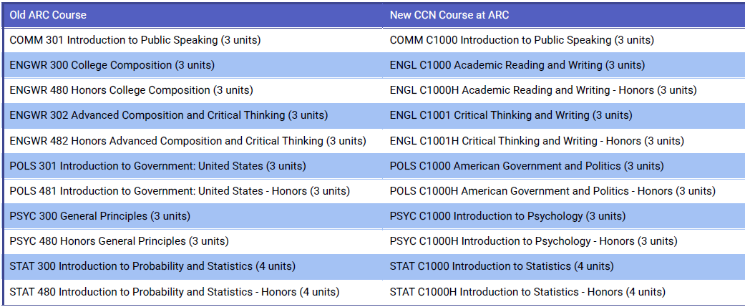
ARC Course Conversion Chart: CCN

Slide 5
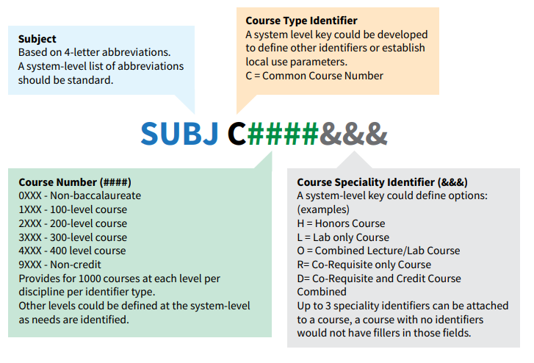
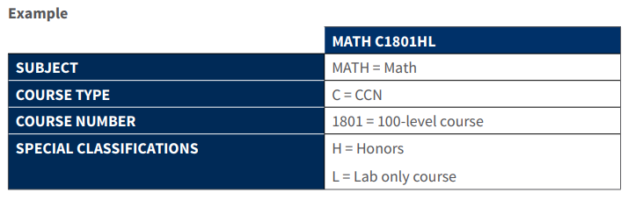
COURSE
NUMBER
SYNTAX

Slide 6
C-ID Number | C-ID Name | Current ARC Designator & Number | ARC Title
ANTH 110/115L | Introduction to Biological Anthropology (with lab) | ANTH 300/301 | Biological Anthropology/Lab
 |  | ANTH 480 | Honors Biological Anthropology
ARTH 110* | Survey of Western Art for Prehistory through the Middle Ages | ARTH 302 | Art: Stone Age Through the Middle Ages
ARTH 120* | Survey of Western Art from Renaissance to Contemporary | ARTH 308 & 310 | Renaissance Tradition in Art & Modern Art (two courses)
BIOL 110B | Human Anatomy with Lab | NA | NA
CHEM 101 | Introduction to Chemistry | CHEM 305 | Introduction to Chemistry
Chemistry sequence
CHEM 120S OR CHEM 110 | General Chemistry for Science Majors Sequence A (one-year sequence and includes two courses), OR General Chemistry for Science Majors I, with Lab (first semester course of the one-year sequence) | CHEM 400 & 401 OR CHEM 400 | General Chemistry I

Slide 7
COMM 130 | Interpersonal Communication | COMM 321 | Interpersonal Communication
CDEV 100 | Child Growth and Development | ECE 312 | Child Development
 |  | PSYC 372 | Child Development
ECON 201* | Principles of Macroeconomics | ECON 304 | Principles of Macroeconomics
ECON 202* | Principles of Microeconomics | ECON 302 | Principles of Microeconomics
ENGL 110* | Argumentative Writing and Critical Thinking Through Literature | ENGWR 303 | Argumentative Writing and Critical Thinking Through Literature
ENGL 120* | Introduction to Literature | ENGWR 301 | College Composition and Literature
 |  | ENGWR 481 | Honors College Composition and Literature
HIST 130* | United States History to 1877 | HIST 310 | History of the United States (To 1877)
 |  | HIST 483 | History of the United States - Honors
HIST 140* | United States History from 1865 | HIST 311 | History of the United States (1865 - Present)
 |  | HIST 484 | History of the United States - Honors

Slide 8
Calculus sequences
MATH 210 | Single Variable Calculus I Early Transcendentals | MATH 400 | Calculus I
MATH 211 | Single Variable Calculus I Late Transcendentals | NA | NA
MATH 220 | Single Variable Calculus II Early Transcendentals | MATH 401 | Calculus II
MATH 221 | Single Variable Calculus II Late Transcendentals | NA | NA
SOCI 110 | Introduction to Sociology | SOC 300 | Introductory Sociology
 |  | SOC 480 | Introductory Sociology - Honors
NA | Astronomy with lab (no-C-ID) | ASTR 300 & 400 | Introduction to Astronomy/Lab
NA | General survey Biology course with lab (no C-ID) | BIOL 303 | Survey of Biology

Slide 9
What’s Not Changing: CCN
ARC faculty added local elements to nearly all the CCN templates in the optional Part 2 sections
  Descriptions, Outcomes, Topics, Methods of Evaluation, Representative Textbooks
For Phase I, a course as taught will likely not be substantially different
  ENGL C1001 will not likely substantively differ from ENGWR 302, etc
Instructors still interpret, apply, and teach the course outline using academic freedom
Students’ records and transcripts will still be honored
  No one who’s successfully completed ENGWR 300 will need to take ENGL C1000, etc
Notes:
Assembly Bill No. 1111 (AB 1111) established new Education Code 66725.5 and stated the following:
(1) To streamline transfer from two- to four-year postsecondary educational institutions and reduce excess credit accumulation, on or before July 1, 2024, both of the following shall occur:
(A) The California Community Colleges shall adopt a common course numbering system for all general education requirement courses and transfer pathway courses.
(B) Each community college campus shall incorporate common course numbers from the adopted common course numbering system in its catalog.
(2) The common course numbering system shall be student facing… and ensure that comparable courses across all community colleges have the same course number

Slide 10
What’s Unknown: CCN
What changes in articulation happen for courses in Phases I-III?
  Currently articulation for GE and major are not a part of the CCN templates–but the hope is for that to change.
Will the timelines change?
  The Phase II templates now have two catalog deadlines
    PII (a), Fall 2026; PII (b), 2027
  Phase III courses set to have initial templates drafted at the end of Summer 25
How CCN changes will affect non-mandated courses?
  After Phase III, what happens?
  Will all transfer courses be renumbered?
  Will local courses be renumbered?
What comes next?

Slide 11
What’s Happening Locally: CCN
In Fall 2025, we will have new titles, numbers, and content for 13 courses across the district
  Prior course numbers are already referenced in the course description of each of the revised CCN courses and will be visible in key places on the schedule and in eServices
We established a district-wide goal to keep these courses as close to identical as possible across the 4 colleges to align transferability, transfer GE approvals, and course-to-course articulation
These new course numbers are showing up in the Fall 2025 catalog and schedule (including on course lists for relevant degrees and certificates)
The new course versions are to be considered identical to the old course versions
Any student who completed one of these courses pre-Fall 2025 does NOT need to take the new version of the course

Slide 12
Preparation for Fall 2025: CCN
There are discussions happening to:
Get information out to students about these changes this semester (hopefully flyers on campus, emails to students, notes on scheduling pages, etc.)
Remove references to the old course numbers in marketing materials, catalogs, web pages, program maps, and any department materials
Create a landing page on the website devoted to this information
Update these courses in our educational plans (iSEPs) and placements in eServices
Train ARC employees so that everyone can work together to guide students appropriately

Slide 13
Ties to IEC: CCN
Streamlined process to award Type B leave to faculty working to implement changes to courses (not related template adoption)
Default part of AUP and Program Review or flexibility in deadlines
  Not every department’s impact will be identical
Catalog review for impacted departments is more extensive
  Much falls on CCN Coordinator (local and District) and Articulation Officer but is part of annual work of chairs/spokespeople (retention issue)
Ripples: prereqs, coreqs, and advisories
  Long-term issues of “eligibility for” statements will repeat in Phase III
  Curriculum would like institutional support in creating readily available data to help support the removal of advisories that create barriers and likely suggest deficit-minded practices

Slide 14
Cal-GETC

Slide 15
What’s Changing: Cal-GETC and ADTs
We are moving from two transfer GE patterns (CSU GE Breadth and IGETC) to a singular GE pattern for transfer to CSU and UC: Cal-GETC
Cal-GETC 1.2 Standards establish rigorous courses for GE
LOTE and US Institutions not included as requirements
Community colleges must place students on Associate Degree for Transfer (ADT) pathways if one exists for a student’s stated major (unless the student opts out)
New unit threshold for some high-unit ADT STEM pathways
Many ADTs have expanded their course lists
  New program maps are being created

Slide 16
What’s not changing: Cal-GETC and ADTs
Cal-GETC is very similar to IGETC (not CSU GE)
  Courses must be UC transferable prior to being submitted for Cal-GETC request
Students that maintain their catalog rights prior to Fall 2025 can still use the CSU GE Breadth and IGETC transfer patterns
The required core of ADT course lists is mostly unchanged
Required units for ADTs hasn’t changed
LOTE and US Institutions are still needed as graduation requirements for UC/CSUs

Slide 17
What Students Need: Cal-GETC and ADTs
ALL new students will use Cal-GETC to complete transfer requirements
  New students include students that took college courses while in high school and graduate in May/June 2025
Continuing students that maintain their catalog rights can choose to use the CSU GE Breadth or IGETC patterns or switch to Cal-GETC
If your students have questions about which GE pattern they should follow, please have them meet with a counselor
Notes:
Cal-GETC_Standards_1v2_2024.pdf (icas-ca.org)

Slide 18
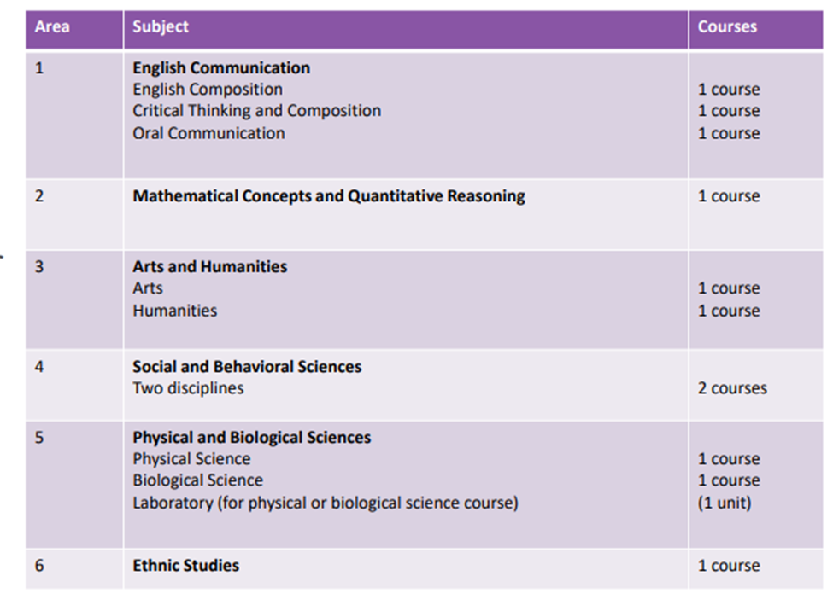
Cal-GETC Pattern
34 unit GE Pattern
Oral Communication included (but redefined)
Arts & Humanities and Social & Behavioral Science limited to two courses
Lifelong Learning & Self Development not included
Language Other Than English is not included
Ethnic Studies included

Slide 19
What’s Happening at ARC: Cal-GETC
Beginning Fall 2025, we will only have the Cal-GETC advising sheet to give to our new students
  This should be available by June, a draft Cal-GETC is available online
Counselors will still have the 24-25 advising sheets for the CSU GE and IGETC patterns and the are accessible in archived versions of the catalog
We need to be aware that new students starting in the summer may have options for their general education and these options really need to be explored with a counselor
We should not be using the old IGETC pattern to advise students, students with IGETC references in their educational plans need to meet with a counselor

Slide 20
Preparation for Fall 2025: Cal-GETC
A GE Guidance webpage has been created for students to learn more about these changes (hopefully information will also go out via flyers on campus and emails to students, etc.)
We have added the draft version of the Cal-GETC GE pattern to the ARC website
We are actively removing references to the CSU GE and IGETC patterns in marketing materials, catalogs, web pages, program maps, and any department materials
Continue to train and educate ARC employees and our partners so that everyone can work together to guide students appropriately

Slide 21
Local General Education

Slide 22
New Los Rios General Education Requirements for AA/AS degrees
Area | Subject | Min Units (sem/quar)
L1 | English Composition, Oral Communication, and Critical Thinking English Composition Oral Communication and Critical Thinking | 3 3
L2 | Mathematical Concepts and Quantitative Reasoning | 3
L3 | Arts and Humanities | 3
L4 | Social and Behavioral Sciences | 3
L5 | Natural Sciences | 3
L6 | Ethnic Studies | 3
L7 | Living Skills (exceptions for high-unit majors) (A) PE (B) Life Development Skills | 1 2
Notes:
The Living Skills local GE requirement is to be defined as per P-7241 as one physical education activity course (with ADAPT, DANCE, FITNS, PACT, SPORT, or TMACT designators) and a minimum of two (2) units from the other courses included in this category which may be selected from a number of different disciplines that help students to acquire skills and knowledge to understand themselves as whole persons (integral to their environment) and develop and maintain personal, social, physical and emotional well-being. Adapted physical education courses are available for students with documented physical disabilities

Slide 23
What’s Happening at ARC: Local GE Pattern
We will have a new 24 unit local GE pattern as of Fall 2025
  Living Skills will continue to be a requirement, but there will be an opt out process for students whose majors are 45 units or more
  American Institutions was removed, but all of those courses are in the Social and Behavioral Sciences GE area
Beginning Fall 2025, all new students seeking a local degree will need to follow this new pattern
Continuing students who maintain their catalog rights can choose to use the old GE pattern or switch to the new pattern
Students can also use Cal-GETC to complete local GE requirements
We aligned the local GE patterns across the district, so a number of courses were added and a few were removed
The English, Reading, Math, and Ethnic/Multicultural Studies competencies will no longer be required on this new local GE pattern

Slide 24
What’s Happening at ARC: Local GE Pattern
Be aware that SOME students will have the ability to follow two different local GE patterns
Student will need help choosing which GE pattern they should use to earn their AA or AS degree
They may need help choosing courses for the old GE pattern
They may need help deciding which classes they should take or how their completed courses can be used on the new local GE pattern
They may also be confused about their catalog rights
More than ever, students need to meet with a counselor

Slide 25
Preparation for Fall 2025: Local GE Pattern
A GE Guidance webpage has been created for students to learn more about these changes (hopefully information will also go out via flyers on campus and emails to students, etc.)
We have added the 25-26 local GE pattern to the ARC website
We are actively removing references to the CSU GE and IGETC patterns in marketing materials, catalogs, web pages, program maps, and any department materials
Continue to train and educate ARC employees and our partners so that everyone can work together to guide students appropriately

Slide 26
Larger Ties to IEC

Slide 27
Preparation for the Future
High Challenge
  Remove outdated and unvalidated advisories
  Review the extensive number of out of date courses and programs
    441 courses beyond 6-year review cycle; 211 beyond 10-year mark
  Delete courses that haven’t been offered in five or more years
  Institutionalize review for IDEAA and UDL, per upcoming changes to Title 5
High Support
  Curriculum review as a required part of Program Review and AUP
    CTE Programs review every 2 years; non-CTE, every 6 years
  Data on Demand to review advisories (for courses) and length to completion (for programs)

Slide 28
Questions?

