Slide 1
American River College
Hispanic Serving Institution
Student Success Council Presentation
Wednesday, October 16, 2024

Slide 2
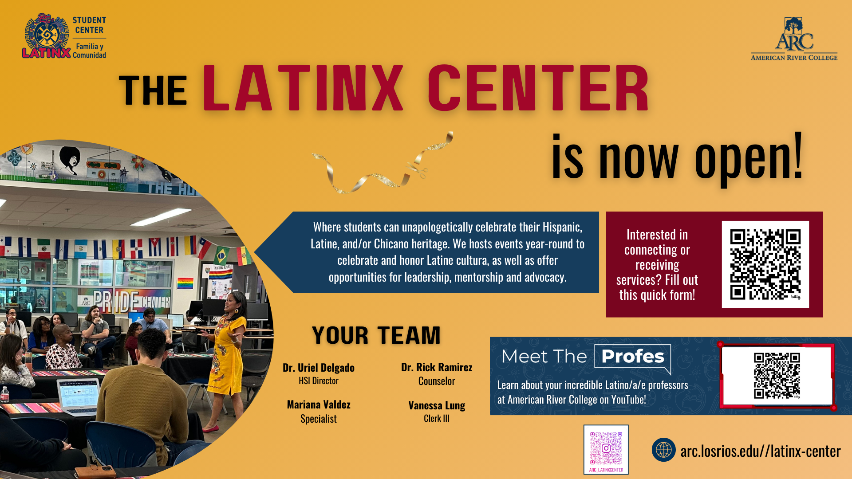

Slide 3
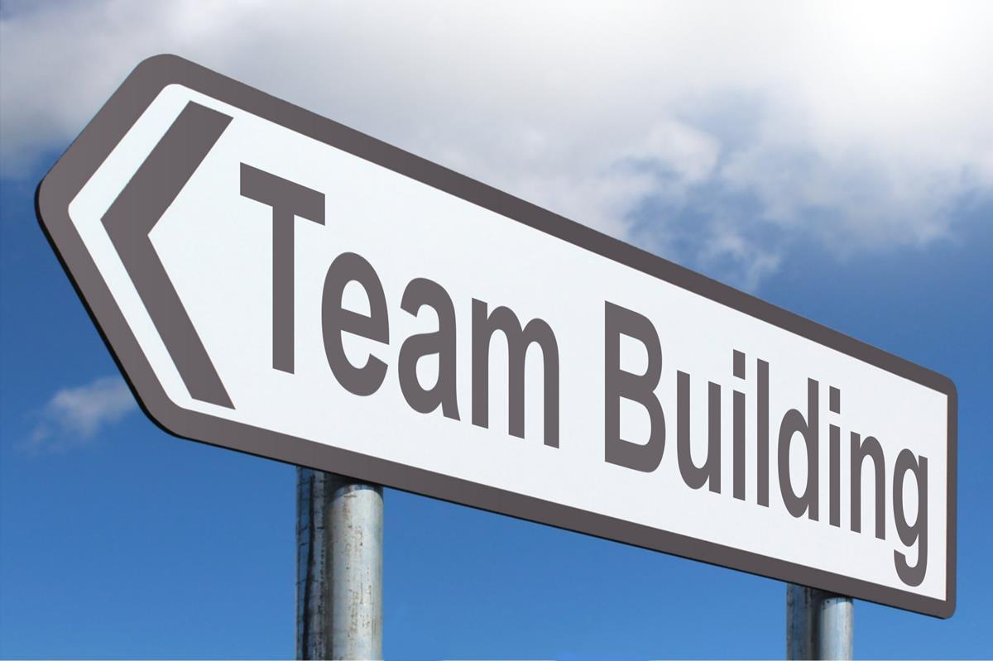
HSI Staffing
Counselor
Dr. Rick Ramirez, transitioned to serve HSI grant (09/17/2024)
Clerk III
Vanessa Lung transitioned to serve HSI grant (09/30/2024).
Student Support Specialist
Mariana Valdez Jimenez transitioned to serve HSI grant (10/07/2024).
Student Ambassadors
In the process of being hired. Job posted (09/11/2024). Interviews will begin the week of (10/07/2024).
Director
Dr. Uriel Delgado transitioned to serve HSI grant (08/15/2024).

Slide 4
What does it mean for ARC to be an HSI?
American River College recognizes the importance of serving Latinx and low-income students. This is especially important because the college enrolls high numbers of minority, low-income and first-generation students.
Objectives
By Sept. 30, 2027, increase the fall-to-fall retention rate among ARC Latinx students to 42.8%. Baseline: 37.8%
By Sept. 30, 2027, increase the three-year (150% time) graduation rate for Latinx students to 10%. Baseline: 5%
By Sept. 30, 2027, improve the percentage of Latinx students transferring to a four-year institution to 11.7%. Baseline: 6.7%
By Sept. 30, 2027, increase the percentage of Latinx students who do NOT require remediation in any course to 34%. Baseline: 24%
By Sept. 30, 2027, increase the percentage of new, first-time in college Latinx students taking one or more core courses to 75%. Baseline: 68.3%

Slide 5
Strategy | How Strategy Will Be Implemented
1: Eliminate equity gaps between Latinx and other students. | 1.1: Develop new support programs for students that address both academic and essential/soft skills. 1.2: Continually collect and analyze data to monitor student success. 1.3: Provide students with safe spaces and culturally-appropriate programming.
2: Increase completion rates among Latinx and low-income students. | 2.1: Partner with faculty members to ensure student progress is being tracked and that students who need additional assistance are identified. 2.2: Develop programming that includes culturally-relevant elements. 2.3: Offer a variety of support programs specific to Latinx students, and include family as participants.
3: Increase access to college education for Latinx and low- income students. | 3.1: Partner with area school districts and four-year institutions to develop pathways to help students through the education pipeline. 3.2: Increase enrollment of minority and low-income students by offering pre-college programming that utilizes culturally-relevant techniques. 3.3: Better market college programs to all students, with information to minority groups provided bilingually and in locations they frequent.
4: Ensure students complete a degree while being able to demonstrate personal and professional readiness for a career or transfer. | 4.1: Provide opportunities for students to learn new information or skills through workshops and other activities. 4.2: Demonstrate skills and behaviors that contribute to the inclusive and respectful sharing of ideas. 4.3: Utilize multiple communication methods that address diversity. 4.4: Critically evaluate information and work with diverse student populations to gather information and make changes as needed to improve the student experience.

Slide 6
Funds
3 Million dollar grant over the next 5 years
  First year of grant 2023 - 2024
Around $599K annual funds
Goal to institutionalize programming and staffing at the end of the five years
Federal vs State funds
Direct funds cannot go towards students who are undocumented

Slide 7
Campus Support
Promotion
  Telling students about the center
  Coming in for support and resources (counseling)
  Early opportunity for students to get involved in the foundation of the center
Exposure
  Inclusion in campus events to promote the center
  Classroom, event, and program presentations to students about the center
  Inclusion in outreach events to inform incoming students about the center
Collaboration
  Opportunities to work with other organizations, clubs, programs directly working with Latino/a populations

Slide 8
Measuring Grant's Effectiveness
Objective 1: By Sept. 30, 2027, increase the fall-to-fall retention rate among ARC Latinx students to 42.8%. Baseline: 37.8% | Quantitative Data: Retention rates for all students and Latinx students. Number of students using the Latinx Center. Number of items borrowed from the Lending Library. Count of workshops held and students attending them. Qualitative Data: Feedback on Latinx Center and Lending Library. Student satisfaction of workshops. Data Collection Procedures: The student information system will track student retention by ethnicity and major. A sign-in system will be set up in the Latinx Center that will track users by student number. This will allow analysis of who is using the facility (ethnicity, year in school, major) and when (day of the week/time of day). A standard satisfaction survey will be developed and provided to students at the end of workshops or other activities in the Latinx Center. Answers will be analyzed and compiled into spreadsheets that denote student age and ethnicity. Focus groups and interviews will be conducted by the External Evaluator to further determine satisfaction. Instruments to be Developed: Sign-in process (electronic). Satisfaction survey. Focus group/interview questions.

Slide 9
Measuring Grant's Effectiveness
Objective 2: By Sept. 30, 2027, increase the three- year (150% time) graduation rate for Latinx students to 10%. Baseline: 5% | Quantitative Data: Graduation rates for all students and Latinx students. Number of students serving as Peer Ambassadors. Number of students using Peer Ambassadors, tracked by year in school, age, ethnicity, major. Percentage of students completing Invitations to Success. Qualitative Data: Peer Ambassador feedback and mentoring logs. User feedback on mentoring programming. Student feedback on Invitations to Success. Data Collection Procedures: The institution’s student information system will be used to track student enrollment through three years to determine the percentage who graduate within three years. A standard evaluation form will be developed and provided once each semester to students who are mentored by Peer Ambassadors. Results will be compiled into databases. Invitations to Success participants will participate in a pre-survey to determine their college knowledge and readiness. They will also submit a post-camp survey. Focus groups and interviews will be conducted by the External Evaluator to further determine satisfaction. Instruments to be Developed: Survey regarding Peer Ambassador program. Invitations to Success pre- and post-survey. Focus group questions.

Slide 10
Measuring Grant's Effectiveness
Objective 3: By Sept. 30, 2027, improve the percentage of Latinx students transferring to a four-year institution to 11.7%. Baseline: 6.7% | Quantitative Data: Transfer rates for all students and Latinx students. Number of students taking part in tutoring and/or transfer workshops. Transfer rates for students who participate in tutoring and/or transfer workshops. Number of attendees at Familia activities. Qualitative Data: Student satisfaction with tutoring. Student satisfaction with transfer activities. Family input regarding events. Data Collection Procedures: The institution’s student information system will be used to track students who complete a program and the National Student Clearinghouse will be used to track transfers. A standard satisfaction survey will be developed and provided to students at the end of each transfer event. Answers will be analyzed and compiled into spreadsheets that denote student age and ethnicity. Once a semester, students who participated in tutoring will be sent an electronic survey to assess their satisfaction with the program. Instruments to be Developed: Tracking method for tutoring and workshop attendance. Satisfaction surveys (tutored students, family members). Focus group and interview questions.

Slide 11
Measuring Grant's Effectiveness
Objective 4: By Sept. 30, 2027, decrease the percentage of Latinx students requiring remediation in any course to 69%. Baseline: 76% | Quantitative Data: Numbers of students served by grant activities, broken down by ethnicity. Percentages of students needing remediation, by ethnicity. Number of students participating in faculty mentoring, including breakdown of time spent with mentor. Number of study groups held, and number of students participating. Qualitative Data: Student satisfaction with services. Faculty feedback on mentoring. Data Collection Procedures: The institution’s student information system will be used to track students as they enter ARC to determine percentages needing remediation. Project staff will be responsible for taking head counts at study groups throughout the grant period. These will be compiled into a database to keep a running tally of attendance. A standard satisfaction survey will be developed and provided to mentored students once per semester. Faculty mentors will participate in a focus group each semester to share feedback on the program. Instruments to be Developed: Satisfaction surveys for study groups. Focus group and interview questions.

Slide 12
Measuring Grant's Effectiveness
Objective 5: By Sept. 30, 2027, increase the percentage of new, first- time in college Latinx students taking one or more core courses to 75% Baseline: 68.3% | Quantitative Data: Numbers of outreach activities developed and offered; number of K-12 students participating. Number of K-12 students participating in summer camps. Qualitative Data: Student satisfaction with services. Data Collection Procedures: Project staff will be responsible for taking head counts at each event/activity throughout the grant period. These will be compiled into a database by the Activity Director, who will keep a running tally of attendance. A short survey will be provided to K-12 students following each outreach event to gauge their interest in the topic as well as information on their future career plans and college aspirations. Surveys will be tailored to each age group, with more information collected from high school groups. Instruments to be Developed: Satisfaction surveys for specific events.

