Slide 1
AB 1705 and the Final Phase of Implementation
Math

Slide 2
STEM-Related Courses
STEM Preparatory Courses
• Math 333: Intro to College Algebra
• Math 372: College Algebra
• Math 373: Trigonometry
• Math 375: Precalculus
Calculus Courses
• Math 340: Business Calculus
• Math 355: Calc for Bio and Med I
• Math 400: Calculus I

Slide 3
Pathways
Business 333 → 340
Biology and Medicine 333 → 373 → 355
STEM 333 → 375 → 400
or 372/373 → 400

Slide 4
Placements (Current)
Students who have not successfully completed Algebra II or Integrated Math 3 are placed into Math 333.
Students who have successfully completed Alg II or IM 3 but not Trig/Precalculus are placed into Math 372/373 and 375.
Students who have successfully completed Precalculus are placed into Math 400.

Slide 5
AB 1705 Implementation
For non-STEM Calculus:
Starting Fall 2024, all Business and Econ majors will receive direct placement into Math 340.
For STEM Calculus:
Starting Fall 2025, all STEM majors will receive direct placement into Math 355 or Math 400, regardless of what mathematics coursework they have completed.

Slide 6
Offering Preparatory Courses
Q: Can ARC offer preparatory course(s) as an option for STEM majors who feel they will not succeed in Calculus I without a foundation in algebra and trigonometry?
A: It depends.
We may offer the choice of taking a preparatory course IF…
The “IF” will take some background to understand.

Slide 7
CCCCO Placement Groups
The CCCCO has split STEM majors into two groups, a high group and a low group, which they call the “Lowest STEM Placement Group.” I’ll just refer to this as the low group.
Definitions
High Group: Successfully completed Trigonometry, Precalculus or Calculus in high school AND has a GPA greater than 2.6.
Low Group: Has not completed Trig, Precalc or Calculus OR has a GPA of 2.6 or lower.

Slide 8
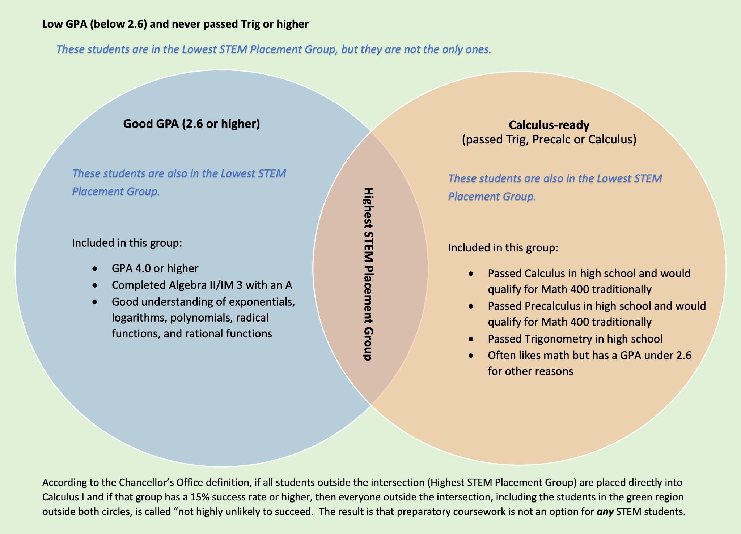

Slide 9
The Low Group Contains Students Who Are Not Very Low
Notice that the low group uses the word “or,” which means…
a student who passed Calculus in high school is in the low group as long as their overall GPA is 2.6 or lower, and
a straight-A student who has a GPA over 4.0 is in the low group if they completed Alg II/IM 3 but nothing further.
The low group contains students with a very strong background, some of whom already passed Calculus!
The low group contains students who have a moderate math background and get straight As.
Let’s keep that in mind as we move forward.

Slide 10
What Validates a Preparatory Course
AB 1705 states that there are three conditions that must be met in order to offer a preparatory course to a STEM major.
The student is highly unlikely to succeed in STEM Calculus I without the preparatory course,
the preparatory course will improve the student’s probability of completing STEM Calculus I, and
the preparatory course will improve the student’s persistence to and completion of STEM Calculus II when required for their major.

Slide 11
Condition #1 as Interpreted by the CCCCO
In February, the CCCCO released their definition of “highly unlikely to succeed” for Condition #1. They decided that every student in the low group is considered not highly unlikely to succeed if the entire low group has a 15% or greater two-year throughput rate with direct placement into STEM Calculus I (Math 400).
What this means:
Imagine 100 students in the low group (which contains some very strong students).
Those 100 students are placed directly into Calculus I.
15 or more of them complete Calculus I successfully within two years.
Then the entire low group is called “not highly unlikely to succeed.”
Result: The first condition for having a prep course is not met, and hence we shall not offer any preparatory course to any student in the low group.

Slide 12
Notes About the CCCCO’s Interpretation
A student who takes Calculus and fails, then backs up to Precalculus and succeeds, and then goes back to Calculus and succeeds is considered a direct-Calculus placement success.
The CCCCO’s definition of the Lowest STEM Placement Group is not supported by any legislation or data.
The CCCCO’s definition of “highly unlikely to succeed” is not supported by legislation or data.

Slide 13
ARC’s Four Options for Fall 2025
Option A – STEM majors will receive direct placement into Math 400 (or 355) and have the option to take a concurrent 2-unit support course (MathS 60). If ARC chooses Option A, then preparatory courses will not be available to any STEM major.
Option B – Apply for full validation status of one or more preparatory courses based on the data provided in our college-specific report. Our data does not meet the threshold to qualify, so this option is not possible for ARC (nor for any of the 116 California Community Colleges).
Option C – Apply for two-year interim period of validation of one or more of our existing preparatory courses by showing 50% or more two-year throughput rate (from start of prep course to completion of Calc I). In order to keep the prep course in Fall 2027, the we must meet the three conditions above.
Option D – Create a new, “innovative” preparatory course which can be offered as an option to the low group for a two-year interim period, after which we must meet the three conditions above.

Slide 14
What Will ARC Math Do?
The ARC Math Department is split between Options A and D. Option D may help a great number of students who are unlikely to succeed in Calculus I without it, but many faculty feel it’s a lot of work, time and energy to create a course that may be prohibited two years later.
Currently, SCC, CRC and FLC are all pursuing Option D (an innovative prep course).
All three colleges will likely have their own unique version of this course.
The thematic block Math 380 to 389 has already been reserved (i.e. Math 385).

Slide 15

What does the Math Department need?
We don’t know.
It may be possible for us to locally define our own “Lowest STEM Placement Group” based on high school metrics. For example, low GPA and no Trig/Precalculus.
Then if that group of students experienced a two-year throughput rate less than 15%, we would meet Condition #1.
If that group also met Conditions #2 and #3, then we could offer a preparatory course to that group.
Would those students continue to try? What would this timeline look like?
We don’t know.

Slide 16
AB 1705 and the Final Phase of Implementation
Math

Slide 17
STEM-Related Courses
STEM Preparatory Courses
• Math 333: Intro to College Algebra
• Math 372: College Algebra
• Math 373: Trigonometry
• Math 375: Precalculus
Calculus Courses
• Math 340: Business Calculus
• Math 355: Calc for Bio and Med I
• Math 400: Calculus I

Slide 18
Pathways
Business 333 → 340
Biology and Medicine 333 → 373 → 355
STEM 333 → 375 → 400
or 372/373 → 400

Slide 19
Placements (Current)
Students who have not successfully completed Algebra II or Integrated Math 3 are placed into Math 333.
Students who have successfully completed Alg II or IM 3 but not Trig/Precalculus are placed into Math 372/373 and 375.
Students who have successfully completed Precalculus are placed into Math 400.

Slide 20
AB 1705 Implementation
For non-STEM Calculus:
Starting Fall 2024, all Business and Econ majors will receive direct placement into Math 340.
For STEM Calculus:
Starting Fall 2025, all STEM majors will receive direct placement into Math 355 or Math 400, regardless of what mathematics coursework they have completed.

Slide 21
Offering Preparatory Courses
Q: Can ARC offer preparatory course(s) as an option for STEM majors who feel they will not succeed in Calculus I without a foundation in algebra and trigonometry?
A: It depends.
We may offer the choice of taking a preparatory course IF…
The “IF” will take some background to understand.

Slide 22
CCCCO Placement Groups
The CCCCO has split STEM majors into two groups, a high group and a low group, which they call the “Lowest STEM Placement Group.” I’ll just refer to this as the low group.
Definitions
High Group: Successfully completed Trigonometry, Precalculus or Calculus in high school AND has a GPA greater than 2.6.
Low Group: Has not completed Trig, Precalc or Calculus OR has a GPA of 2.6 or lower.

Slide 24
The Low Group Contains Students Who Are Not Very Low
Notice that the low group uses the word “or,” which means…
a student who passed Calculus in high school is in the low group as long as their overall GPA is 2.6 or lower, and
a straight-A student who has a GPA over 4.0 is in the low group if they completed Alg II/IM 3 but nothing further.
The low group contains students with a very strong background, some of whom already passed Calculus!
The low group contains students who have a moderate math background and get straight As.
Let’s keep that in mind as we move forward.

Slide 25
What Validates a Preparatory Course
AB 1705 states that there are three conditions that must be met in order to offer a preparatory course to a STEM major.
The student is highly unlikely to succeed in STEM Calculus I without the preparatory course,
the preparatory course will improve the student’s probability of completing STEM Calculus I, and
the preparatory course will improve the student’s persistence to and completion of STEM Calculus II when required for their major.

Slide 26
Condition #1 as Interpreted by the CCCCO
In February, the CCCCO released their definition of “highly unlikely to succeed” for Condition #1. They decided that every student in the low group is considered not highly unlikely to succeed if the entire low group has a 15% or greater two-year throughput rate with direct placement into STEM Calculus I (Math 400).
What this means:
Imagine 100 students in the low group (which contains some very strong students).
Those 100 students are placed directly into Calculus I.
15 or more of them complete Calculus I successfully within two years.
Then the entire low group is called “not highly unlikely to succeed.”
Result: The first condition for having a prep course is not met, and hence we shall not offer any preparatory course to any student in the low group.

Slide 27
Notes About the CCCCO’s Interpretation
A student who takes Calculus and fails, then backs up to Precalculus and succeeds, and then goes back to Calculus and succeeds is considered a direct-Calculus placement success.
The CCCCO’s definition of the Lowest STEM Placement Group is not supported by any legislation or data.
The CCCCO’s definition of “highly unlikely to succeed” is not supported by legislation or data.

Slide 28
ARC’s Four Options for Fall 2025
Option A – STEM majors will receive direct placement into Math 400 (or 355) and have the option to take a concurrent 2-unit support course (MathS 60). If ARC chooses Option A, then preparatory courses will not be available to any STEM major.
Option B – Apply for full validation status of one or more preparatory courses based on the data provided in our college-specific report. Our data does not meet the threshold to qualify, so this option is not possible for ARC (nor for any of the 116 California Community Colleges).
Option C – Apply for two-year interim period of validation of one or more of our existing preparatory courses by showing 50% or more two-year throughput rate (from start of prep course to completion of Calc I). In order to keep the prep course in Fall 2027, the we must meet the three conditions above.
Option D – Create a new, “innovative” preparatory course which can be offered as an option to the low group for a two-year interim period, after which we must meet the three conditions above.

Slide 29
What Will ARC Math Do?
The ARC Math Department is split between Options A and D. Option D may help a great number of students who are unlikely to succeed in Calculus I without it, but many faculty feel it’s a lot of work, time and energy to create a course that may be prohibited two years later.
Currently, SCC, CRC and FLC are all pursuing Option D (an innovative prep course).
All three colleges will likely have their own unique version of this course.
The thematic block Math 380 to 389 has already been reserved (i.e. Math 385).

Slide 30
What does the Math Department need?
We don’t know.
It may be possible for us to locally define our own “Lowest STEM Placement Group” based on high school metrics. For example, low GPA and no Trig/Precalculus.
Then if that group of students experienced a two-year throughput rate less than 15%, we would meet Condition #1.
If that group also met Conditions #2 and #3, then we could offer a preparatory course to that group.
Would those students continue to try? What would this timeline look like?
We don’t know.

