Slide 1
Student Communications
At American River College
Notes:
Not an area of expertise t
Area of interest after redesign work
Want to bring to Council to see if we would like to facilitate any exploration/action in this area

Slide 2
Spring 2020 SSC Communications Discussion
Request to consider taking up Communication Improvement brought to the SSC in Spring 2021. At the time the council made two recommendations:
Hold a series of “listening sessions” with various departments/offices/employee groups around communication.
  What is working?
  What are some of the problems/issues people are seeing?
  What common questions do their students have in response to communications?
  And use feedback from those sessions to improve communication
Develop a communications “best practices” training that the PIO can offer to groups that want it.
I am returning to the council to determine if we would like to further pursue communication improvements and explore solutions that address ARC’s equity gaps and more effectively serve students.
Notes:
Came to council in 2021 to discuss communications at a different time in out planning and development
Made some recommendations but it wasn’t take for the council to take action

Slide 3
Context
Is this a good time to explore important student communications and how to best coordinate them within ARC and with our LRCCD counterparts?
  Our commitment to racial equity includes the cultural relevance and efficacy of our messaging
  Homebases are established
  District is centralizing Financial Aid and some elements of Admissions
  LRCCD is selecting Customer Relationship Management (CRM) tool

Slide 4
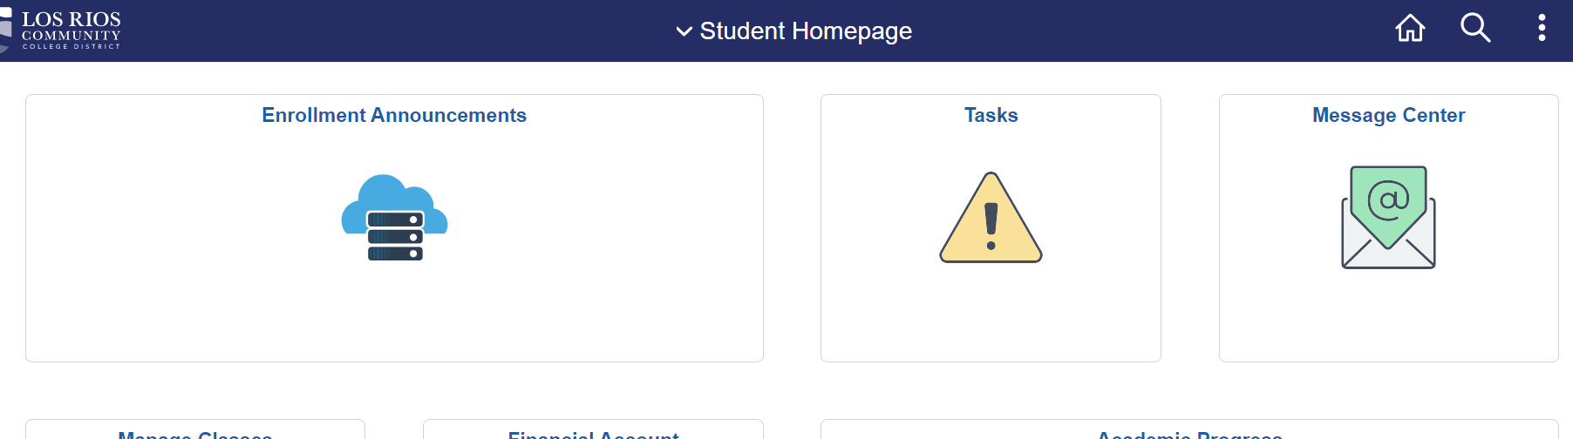
Modes of Communication
Canvas
Los Rios Gmail
Preferred Email
Some Text Messages - Opt In
Three places in eServices

Slide 5
Areas of Concern
1)Many students who are struggling are not seeking help from our campus services indicating that our messaging may lack cultural competence, clarity, and efficacy.
2)The College and District are over emailing and under communicating with students:
  Unclear or difficult action steps– barriers to accessing services are unaddressed
  High volume– student inboxes are full and many students to not regularly check email messages
  Low salience- language is not culturally relevant, is confusing, or unclear how it relates to the student
  Impersonal- promotional materials are easy to ignore, and mass emails can be alienating and frustrating for students
3) Lack of coordination or intentionality regarding who sends messages and which modes of communication are employed.
Notes:
Identified by the redesign team and by students and collogues.

Slide 6

Current Approach: Promotional Material

Slide 7
Proposed Approach:
Personal & Direct Invitation
Text message and email communications in addition to marketing materials.
Hi Taylor,
It looks like you are taking STAT 300 this semester and I am just checking in to see how it is going. If you want to connect with a tutor for help with that class, Wendy has Zoom tutoring sessions M, W 3:00-5:30 through the LRC Tutoring Program. You can sign up anytime.
If you have questions about any of your other classes or I can do something else to help, let me know!
Sam,
Arts Homebase Peer Mentor

Slide 8
Current Approach: District Communications
You have recently been placed on Academic Probation 1 (AP1) or Progress Probation 1 (PP1). This means that at the end of the last term you completed, your cumulative GPA was below 2.0, or you have successfully completed fewer than 50% of the total units you have attempted.
What does this mean for you? After two consecutive terms of Academic or Progress Probation you may not be eligible for priority registration. You may also lose eligibility for the California College Promise Grant (formerly BOG Fee Waiver). This includes students in special programs such as DSPS, EOPS, CalWORKs, and Veterans. After three consecutive semesters of Academic or Progress Probation you may be dismissed from the school.
It’s not too late to get help! There are a number of academic and student support services available to help you get back on track, like tutoring, resource centers, and wellness support. To learn more about how you can get help, contact the home college where you received your Probation or Dismissal.
ARC: Counseling Office, (916) 484-8844
CRC: Counseling Office, (916) 691-7316
FLC: Program for Academic Success & Support, (916) 608-6730
SCC: Counseling Office, (916) 558-2204
You may appeal the loss of priority registration if you have a term GPA of 2.0 and have completed more than half the attempted units for the term. For more information please visit https://losrios.edu/admissions/enroll-in-classes/loss-of-priority-registration
Notes:
Older version so this is just an example of the challenges:
Students Also get an eServices task, email from college about Probation, FA about eligibility, maybe other communications
Student have 4 different concerns :
1)Academic/Progress probation -
you are in one or the other
Doesn’t say that some colleges place a registration hold and some don’t
Dismissed if –GPAs stays below a 2.0 for three semesters doesn’t say what that means - ARC hold goes on after a grace semester
2) Registration Priority
You will lose it after two terms of probation (even if you have EOPS, DSPS, etc) if you don’t ready carefully you will might thing it is saying you will lose EOPS
You can appeal it using this link
3) Financial Aid
You lose your CA promise grant after two semesters
Doesn’t mention that you also lose your FAFSA (separate email/eservices) b/c there’s a different message about that
4) Seek help: phone numbers for counseling for each college
Counseling phone number is not the best place to send students but can’t get too specific because it goes to whole district
The DO message wasn’t exactly inaccurate but it can’t be that helpful because it needs to be accurate for all four colleges

Slide 9
Proposed Approach:
Coordinate with District Admissions and Records and Financial Aid teams to maximize effectiveness of communications addressing financial and academic concerns.
Use a CRM to break students into smaller populations so that information can be more specific and easy to act on. This can also connect them with their UNITE center program, Learning Community, Homebase, or Categorical Program. We could make statements like:
  You are on Academic Probation, so let’s meet to discuss this. Book an appointment so we can go over the details. A few things you should know:
    This will change your registration date from ___ to ___ but won’t effect your other EOPS Services. Fill out this petition to be able to register on your original date.
    Your California Promise Grant will be in place for next semester but you must improve your GPA for Spring 2023 to keep it.
    You will be getting an email- from Financial Aid about Satisfactory Academic Progress. We can talk about this more when we meet.

Slide 10
Possible SSC Actions
Support a communications audit or information gathering effort for Spring 2023. We are exploring a plan to have HB Peers track all college and district communications for the semester.
Create a Communications workgroup in Fall 2023 to review information, explore possible improvements, and make recommendations to the Student Success Council and the Executive Leadership team.

Slide 11
Ideas for a Proposed
Fall 2023 Communications Group
Students, faculty, and administrators can use the student data collected in Spring 2023, the ARC Disproportionality Impacted Groups’ research, additional sources exploring social science in student communications, and equity-informed practices to:
Determine how to develop trust and insure a manageable volume of communications
Create a guide and training materials regarding effective modes of communication, language, calls to actions, etc.
Make recommendations to SSC and ELT regarding:
  Coordinating messaging with DO and internally at ARC
  Using communications to better support students belonging to Disproportionately Impacted groups
  Communications training and support for the ARC Homebases, Learning Communities, and departments

